Slide 1

FORGOTTEN PATIENTS
Why do some patients wait so long to find out what's wrong with them?
A health journalist's perspective
Notes:
I'm afraid I haven't got the answer to this question, I'm not medically qualified and I'm here just to give a journalist's perspective on the stories we hear every day. I've been a journalist for 39 years working for national newspapers, women's magazines and medical trade titles, writing mostly about health and medical stories and I've developed a niche in case study led stories. I've listened to thousands of people over the years and these are just of the things I hear on a fairly regular basis.

Slide 2

WHAT'S UP WITH YOUR GUT?
What’s Happening With Your Gut? - Hammersmith Books
Notes:
I had the idea for this book which was co-authored by Professor Julian Walters when I did a story with him about Bile Acid Diarrhoea or Bile Acid Malabsorption and Professor Walters explained how BAD could be responsible for a third of cases of IBS where diarrhoea is the predominant symptom and yet no one has ever heard of it, despite there being a screening test and a treatment. After writing about IBS for decades I was shocked I'd never heard of it either . Then I started thinking about all the other gut conditions such as non coeliac gluten sensitvity, SIBO and coeliac disease where people can wait a long time for a diagnosis and Professor Walters and I decided to write a book aimed at patients with mystery gut symptoms to help find out what could be wrong.

Slide 3
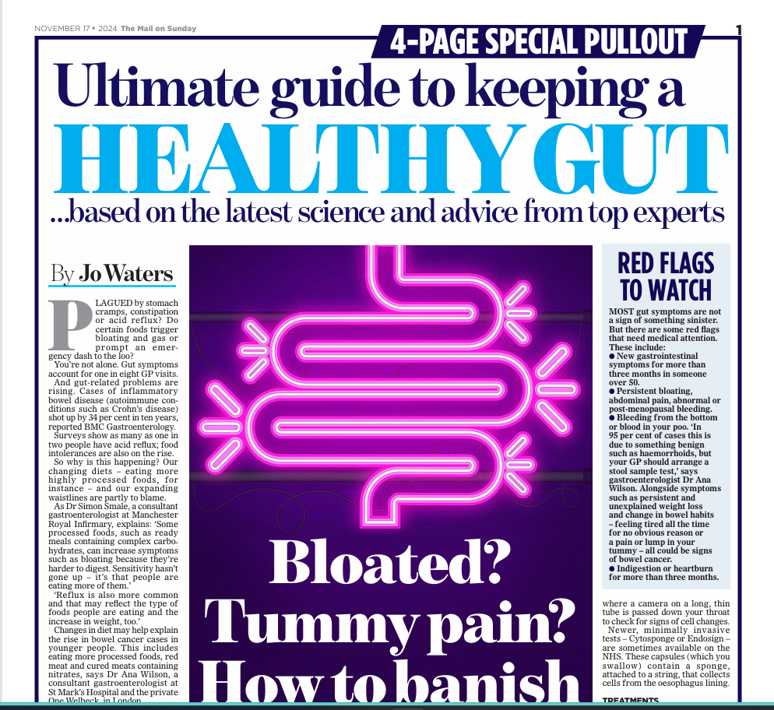
EDS
Notes:
There's a huge thirst for knowledge from people who want to know what's wrong with the m – pull out expert guide symptoms like this one sell a lot of newspapers and online clicks.

Slide 4
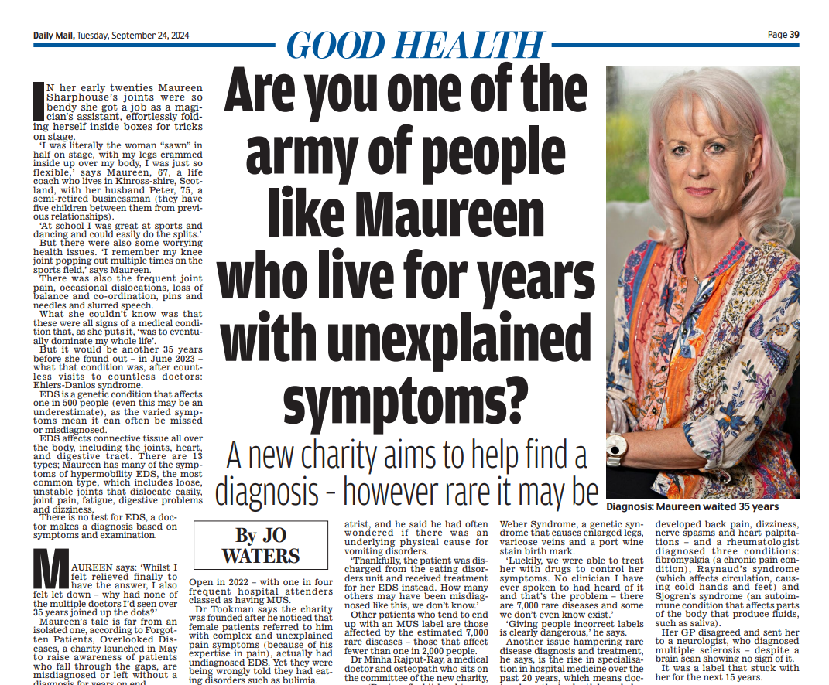
EDS
Notes:
This was a feature I wrote last year with the help of the Forgotten Patients charity highlighting Maureen Sharphouse's 35 year battle to get a diagnosis for her collection of debilitating symptoms. She was so bendy as a teenager and in her early twenties hat she got a job as a magician's assistant effortlessly folding herself into a box to be sawn in half on stage.But she was plagued by multiple random dislocations and later other symptoms such as heart palpitations, joint pain , fatigue etc. Maureen asked ' Why did no doctor ever join up the dots?

Slide 5
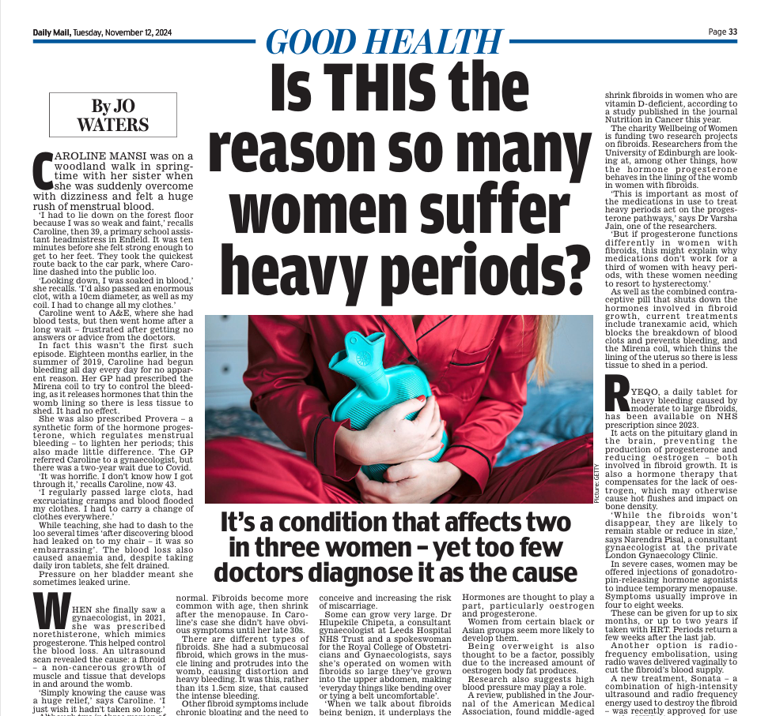
Notes:
Heavy periods seem to be another area where women struggle to get a diagnosis for the cause – with average time for a an endometriosis diagnosis around 8 years. There are also delays with fibroids and one third of women waiting 2 year or more for PCOS diagnoses according to one study. I interviewed one woman who waited decades to be diagnosed with von Willebrand disease.
From talking to women who have had these problems common themes to emerge were not knowing what was normal, being told their symptoms were normal and facing long delays for gynaecology outpatients and investigations in secondary care . I'd say awareness of these conditions is a lot higher now after books like Emma Barnet's Period! And the campaigning work of women's health charities including the Endometriosis Society.

Slide 6

Other 'mystery' symptoms
- fatigue
- bloating
- headaches
- back pain
- heart palpitations
Notes:
I've written hundreds of these stories over the last 35 years or so – I could go on and on - fibromyalgia , chronic fatigue, Lyme Disease. Sometimes they are vague symptoms – people I have interviewed have talked about not seeing the same doctor twice, none joining up the dots , only being allowed to talk about one problem at a time, or being sent to the wrong speciality – for example women in perimenopause being sent to rheumatologists for joint problems or cardiologists for palpitations, when the underlying cause was menopause.
Sometimes people have rare or unusual symptoms of common conditions or have symptoms of rare conditions. It's frustrating for patients and their doctors too not to know the cause.

Slide 7
What interviewees say – some common themes

Slide 8
I don't feel believed
Notes:
Many interviewees talk about being labelled as a difficult or anxious patient who is then passed from pillar to post or written off as having mental health problems

Slide 9
My doctor doesn't listen – they haven't got the time

Slide 10

Noone joined up the dots

Slide 11

Notes:
What are the solutions ?I haven't got the answers and I'm not passing judgement on doctors – you all do an amazing job. People have suggested that like the rest of us doctors could make more use of AI to inform their consultations, patients could be briefed on how to ask the right questions to get the most of consultation , longer consultations (especially for patients with unexplained symptoms) and greater consistency – seeing the same doctor may all help. Other tips might be encouraging patients to keep symptoms diaries and ask them what they think the problems is and even doctors owning up and saying I don't know the cause but I'll do all I can to find out.

