Slide 1
Challenges in the consultation:
Why is it hard to diagnose rare and genetic conditions?
Louise Fish, patient advocate

Slide 2
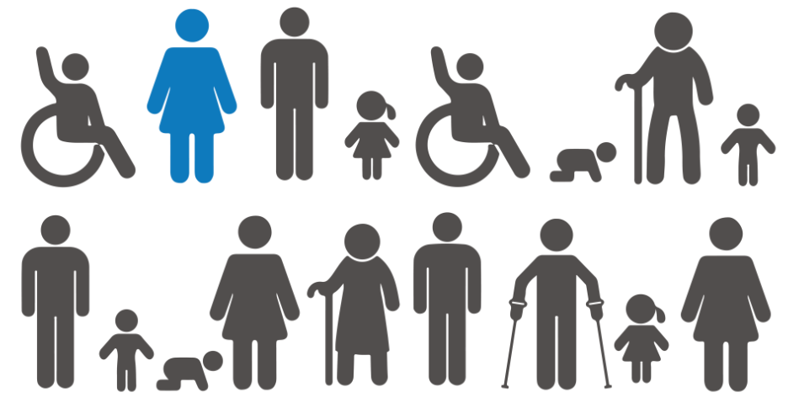
Rare conditions
1 in 17 people are affected by rare condition in their lifetime, which adds up to 3.5 million people across the UK.
There are over 7,000 rare and genetic conditions.
8 in 10 rare conditions are caused by a change to someone’s genetic code.
Some rare gene disorders affect only 1 or 2 people in the UK and a handful of people around the world.
Credit: Genetic Alliance UK

Slide 3
Diagnosis
More than a third of people with a rare condition have to wait more than 5 years between first experiencing symptoms and receiving a final diagnosis.
Not everyone receives a clear diagnosis: The 100,000 Genomes Project helped 1 in 4 people with an undiagnosed rare condition receive a diagnosis for the first time.
Every year around 6,000 children in the UK are born with a genetic condition so rare that it does not yet have a name (a ‘syndrome without a name’ or SWAN).
Credit: Genetic Alliance UK
Notes:
SWAN - This might be because the right test has not yet been developed to diagnose it, or the genetic cause of the condition has not been discovered.

Slide 4
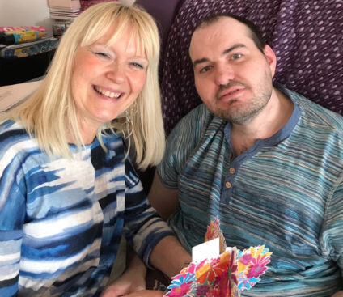
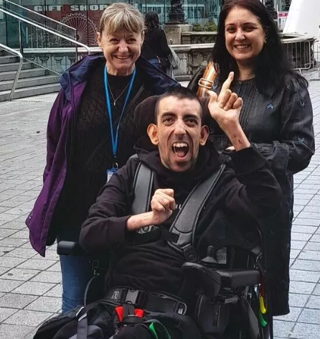

Why does diagnosis matter?
Only 1 out of 20 rare conditions have an approved treatment or medicine to help. Credit, Genetic Alliance UK
Credit: Tuberous Sclerosis Association
Credit: DEBRA
Credit: Turner Syndrome Society
Notes:
Marie James and son Tristan; young man living with epidermolysis bullosa (great photo!), Emma Woods whose family have set up a fund she was keen photographer and passionate about early diagnosis

Slide 5
What about when diagnosis is not possible?
Focus on understanding the patient and wider family’s needs, refer and signpost them for symptom-based help from NHS and wider services wherever possible:
  Help with managing pain and fatigue
  Help with managing anxiety and depression
  Physiotherapy
  Speech and language therapy
  Support for autism, ADHD, learning disability or challenging behaviour.
Understand and acknowledge the emotional impact on a patient and their wider family of not having a diagnosis.
Signpost to patient organisations that can help people to cope with uncertainty and lack of diagnosis, and put them in touch with their peers.

Slide 6
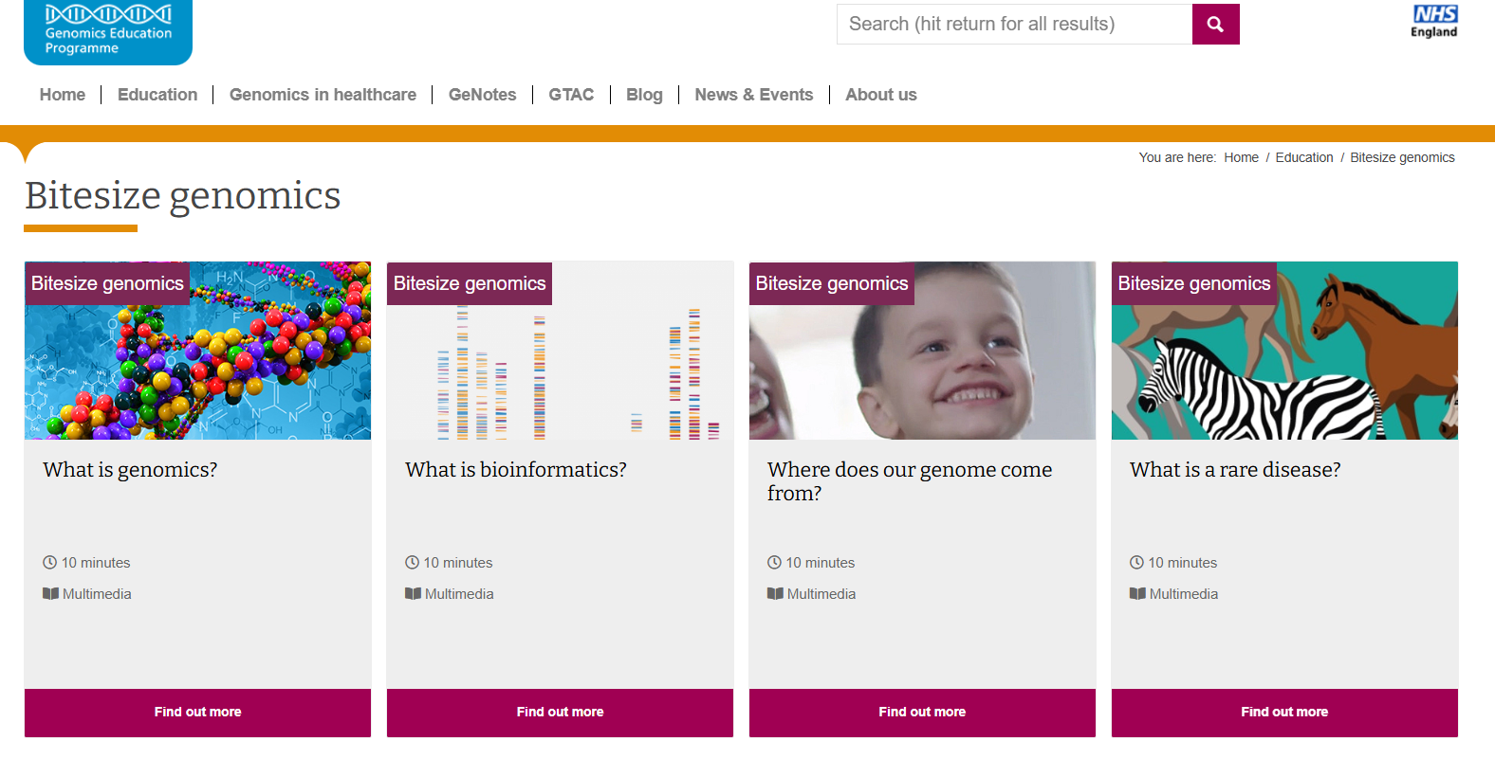
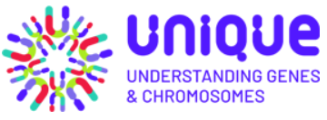
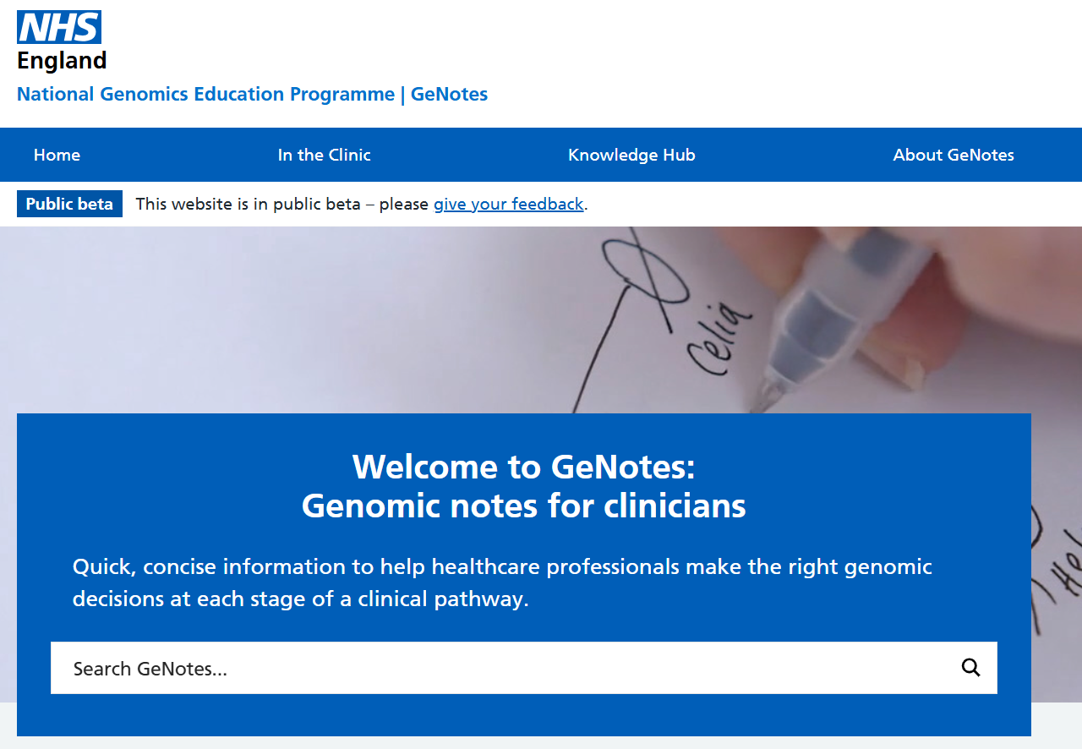
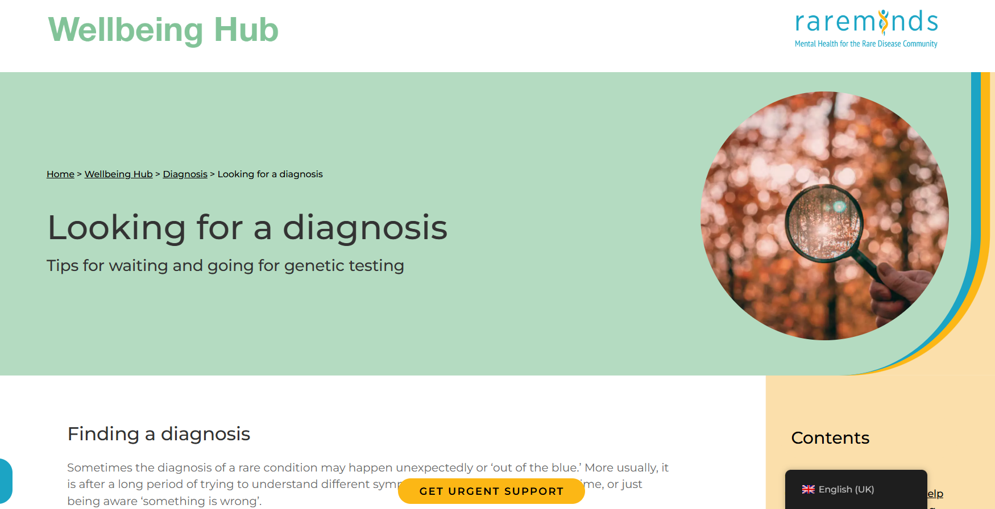
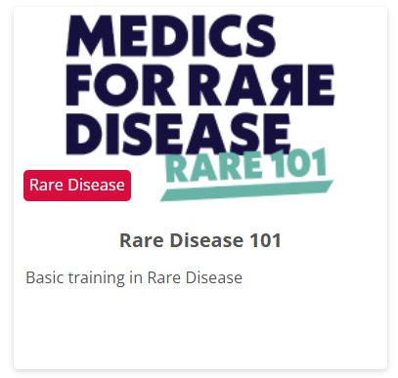
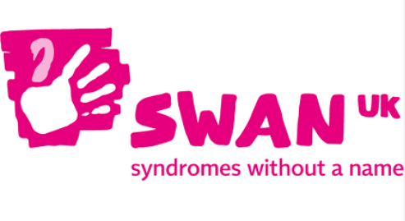
Resources for patients and professionals
For patients and families
SWAN
Unique
Rare Minds
For healthcare professionals
Medics for Rare Disease
  Rare Disease 101
Genomics Education Programme
  Bitesize genomics (online, on-demand learning)
  GeNotes on rare and genetic conditions

