Slide 1
FPOD…The problem of MUS
Forgotten Patients, Overlooked Diseases
Registered Charity

Slide 2
This is about…..
  There are loads of Rare diseases and rare disease charities
  BUT you can only access their help if you have a diagnoses
  There is no overarching body that can offer advice on how to access the correct support
  People get lost in the system searching for help

Slide 3
This is about…..
Diagnosing rare diseases
  There are loads of Rare diseases and rare disease charities
  BUT you can only access their help if you have a diagnoses
  There is no overarching body that can offer advice on how to access the correct support
  People get lost in the system searching for help

Slide 4
This is about…..
Diagnosing rare diseases
  There are loads of Rare diseases and rare disease charities
  BUT you can only access their help if you have a diagnoses
  There is no overarching body that can offer advice on how to access the correct support
  People get lost in the system searching for help

Slide 5
This is about…..
Diagnosing rare diseases
  There are loads of Rare diseases and rare disease charities
  BUT you can only access their help if you have a diagnoses
  There is no overarching body that can offer advice on how to access the correct support
  People get lost in the system searching for help

Slide 6
This is also about…..

Slide 7
This is also about…..
Misdiagnosis of ‘common’ diseases
  e.g
    Endometriosis
    Pre-menopause
    Mast cell activation syndrome
    Hypermobility/EDS
    Etc etc etc

Slide 8

We work in a ‘system’ which…..
Encourages us to MAKE a diagnosis
Wants us to ‘label’ people and illness
Is now designed in Silos
  Loss of the General Physician
Has strict rules
  About appointment times
  Funding
Loves the tick-box approach
Doesn’t acknowledge we go to work to do a ‘good job’

Slide 9
We work in a ‘system’ which…..
Encourages us to MAKE a diagnosis
Wants us to ‘label’ people and illness
Is now designed in Silos
  Loss of the General Physician
Has strict rules
  About appointment times
  Funding
Loves the tick-box approach
Doesn’t acknowledge we go to work to do a ‘good job’

Slide 10
We work in a ‘system’ which…..
Encourages us to MAKE a diagnosis
Wants us to ‘label’ people and illness
Is now designed in Silos
  Loss of the General Physician
Has strict rules
  About appointment times
  Funding
Loves the tick-box approach
Doesn’t acknowledge we go to work to do a ‘good job’

Slide 11
We work in a ‘system’ which…..
Encourages us to MAKE a diagnosis
Wants us to ‘label’ people and illness
Is now designed in Silos
  Loss of the General Physician
Has strict rules
  About appointment times
  Funding
Loves the tick-box approach
Doesn’t acknowledge people go to work to do a ‘good job’

Slide 12

You’re NOT given permission to say…

Slide 13

You’re NOT given permission to say…
“I’m not sure what’s going on?”
“Need a bit of time to think about this”

Slide 14

What is going on?? – NUMBERS (Info from Eurodis)

Slide 15
What is going on?? – NUMBERS (Info from Eurodis)
A rare disease affects fewer than 1 IN 2000 people.
BUT
  THERE ARE OVER 6000 distinct rare diseases.
  An estimated 30 MILLION people are living with a rare disease in 48 countries in Europe
Rare diseases affect about 4% of the population during their lifetime with estimates ranging from 3.5% to 5.9%.
5 YEARS is the time it takes on average for rare disease patients to get a diagnosis.
  70% of people with rare diseases wait more than 1 year to get a confirmed diagnosis after coming to medical attention.

Slide 16
What is going on?? – NUMBERS (Info from Eurodis)
A rare disease affects fewer than 1 IN 2000 people.
BUT
  THERE ARE OVER 6000 distinct rare diseases.
  An estimated 30 MILLION people are living with a rare disease in 48 countries in Europe
Rare diseases affect about 4% of the population during their lifetime with estimates ranging from 3.5% to 5.9%.
5 YEARS is the time it takes on average for rare disease patients to get a diagnosis.
  70% of people with rare diseases wait more than 1 year to get a confirmed diagnosis after coming to medical attention.

Slide 17
What is going on?? – NUMBERS (Info from Eurodis)
A rare disease affects fewer than 1 IN 2000 people.
BUT
  THERE ARE OVER 6000 distinct rare diseases.
  An estimated 30 MILLION people are living with a rare disease in 48 countries in Europe
Rare diseases affect about 4% of the population during their lifetime with estimates ranging from 3.5% to 5.9%.
5 YEARS is the time it takes on average for rare disease patients to get a diagnosis.
  70% of people with rare diseases wait more than 1 year to get a confirmed diagnosis after coming to medical attention.

Slide 18
What is going on?? - IMPACT (Info from Eurodis)

Slide 19
What is going on?? - IMPACT (Info from Eurodis)
2/3 OF FAMILY CARERS spend more than 2 hours a day on disease-related tasks.
7 IN 10 PEOPLE LIVING WITH RARE DISEASES AND FAMILY CARERS reduce or stop professional activity due to their or their family member’s rare disease.
The proportion of people with rare diseases who report FEELING DEPRESSED is 3 TIMES HIGHER than that of the general population.

Slide 20
Sophie’s story
Diagnosed as anorexia
  Weight loss ++
Unwell and ‘angry’
  Screaming
  Locks herself in toilet
BUT
  Hypermobile
  Stretched scars

Slide 21
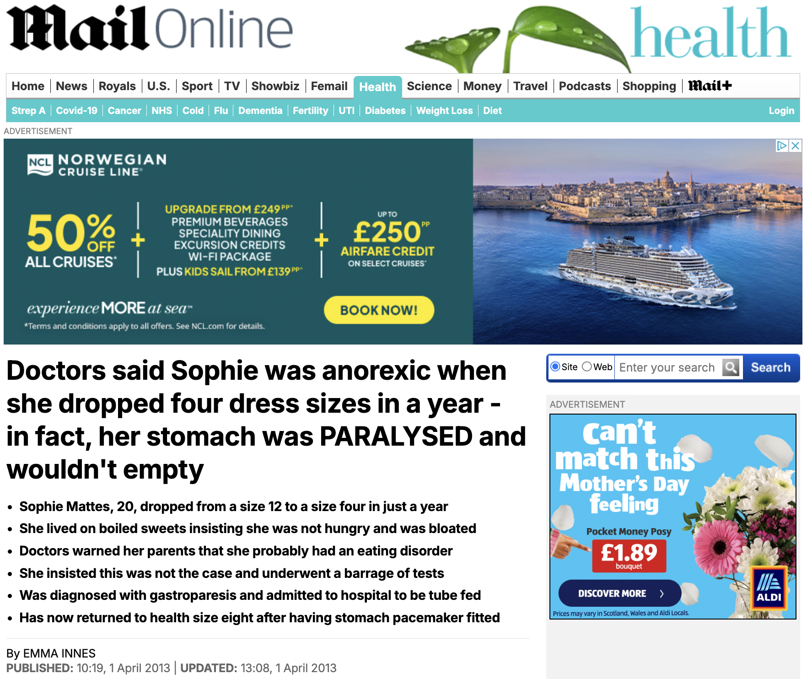

Slide 22
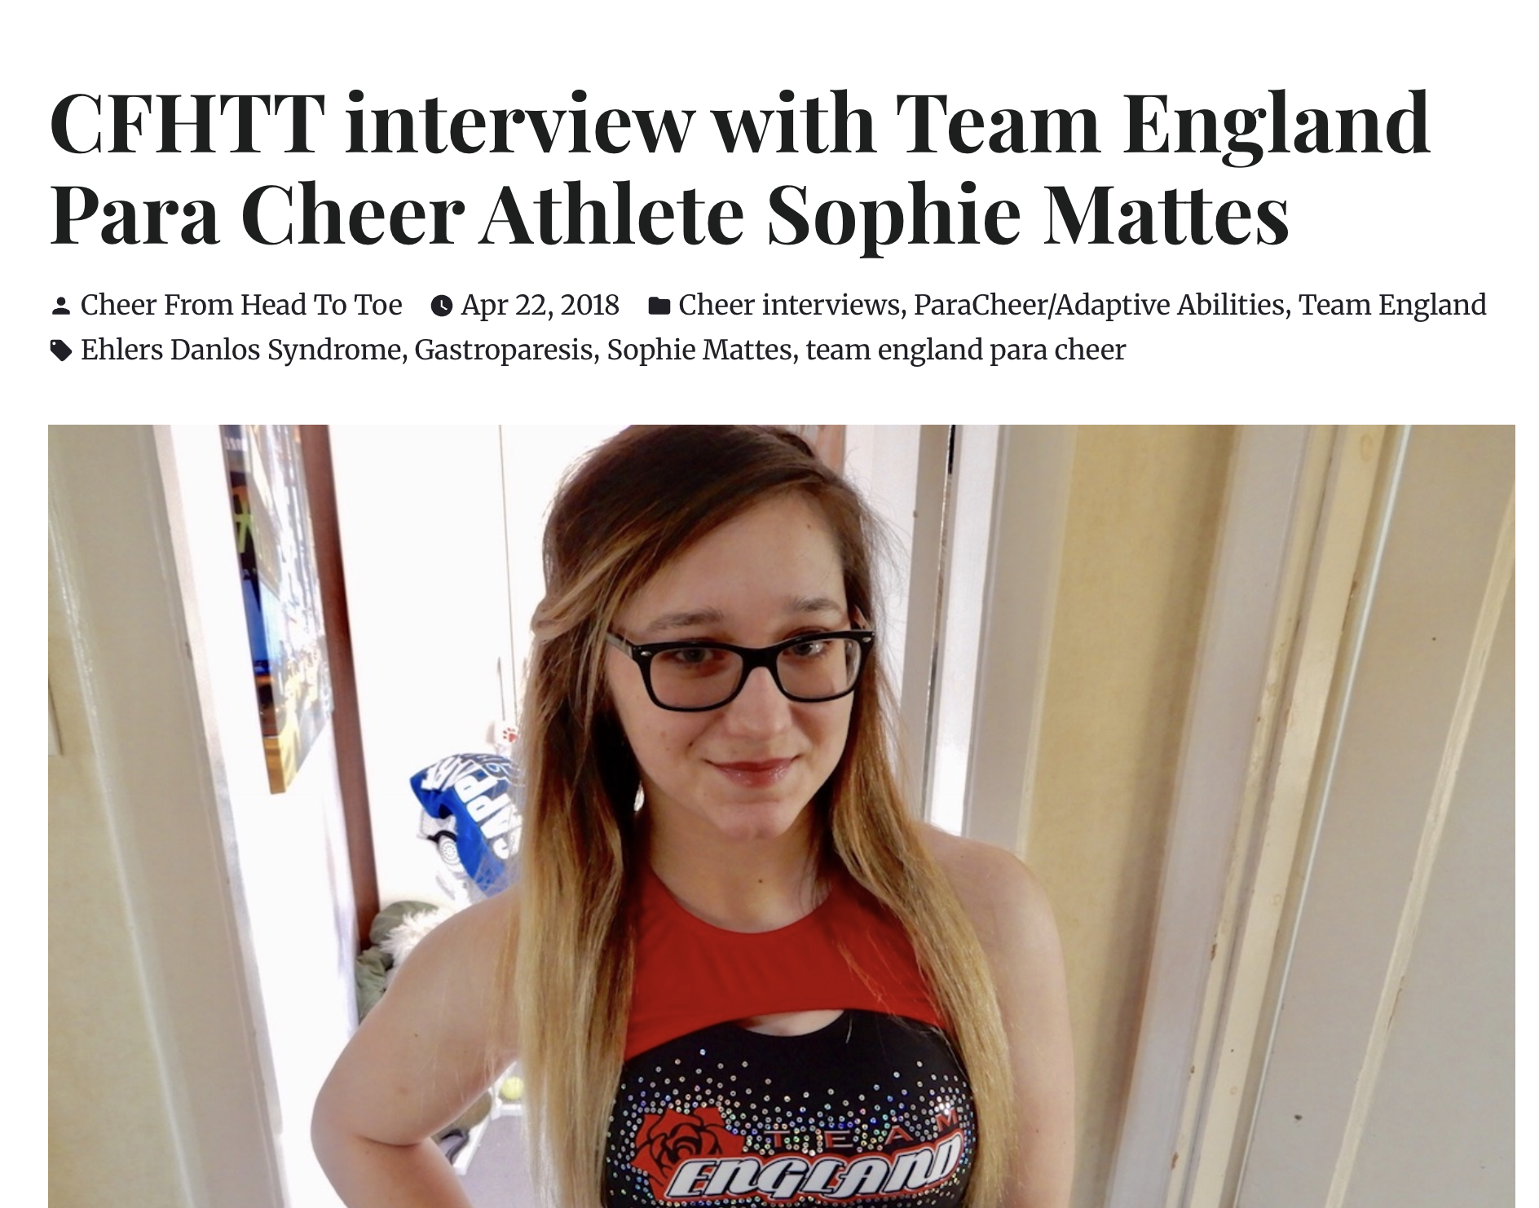
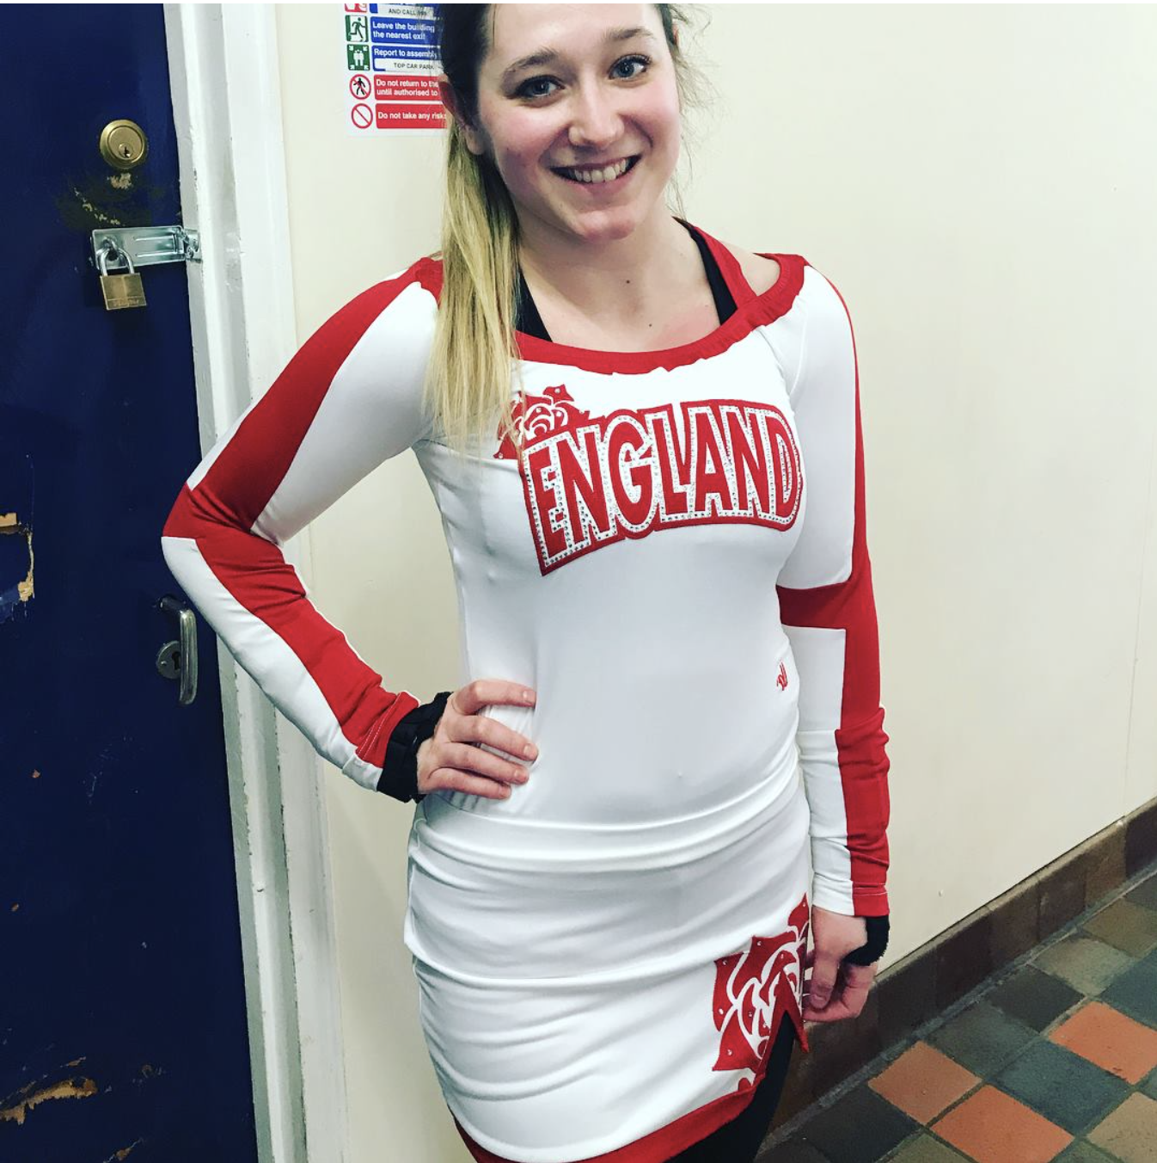

Slide 23


Slide 24
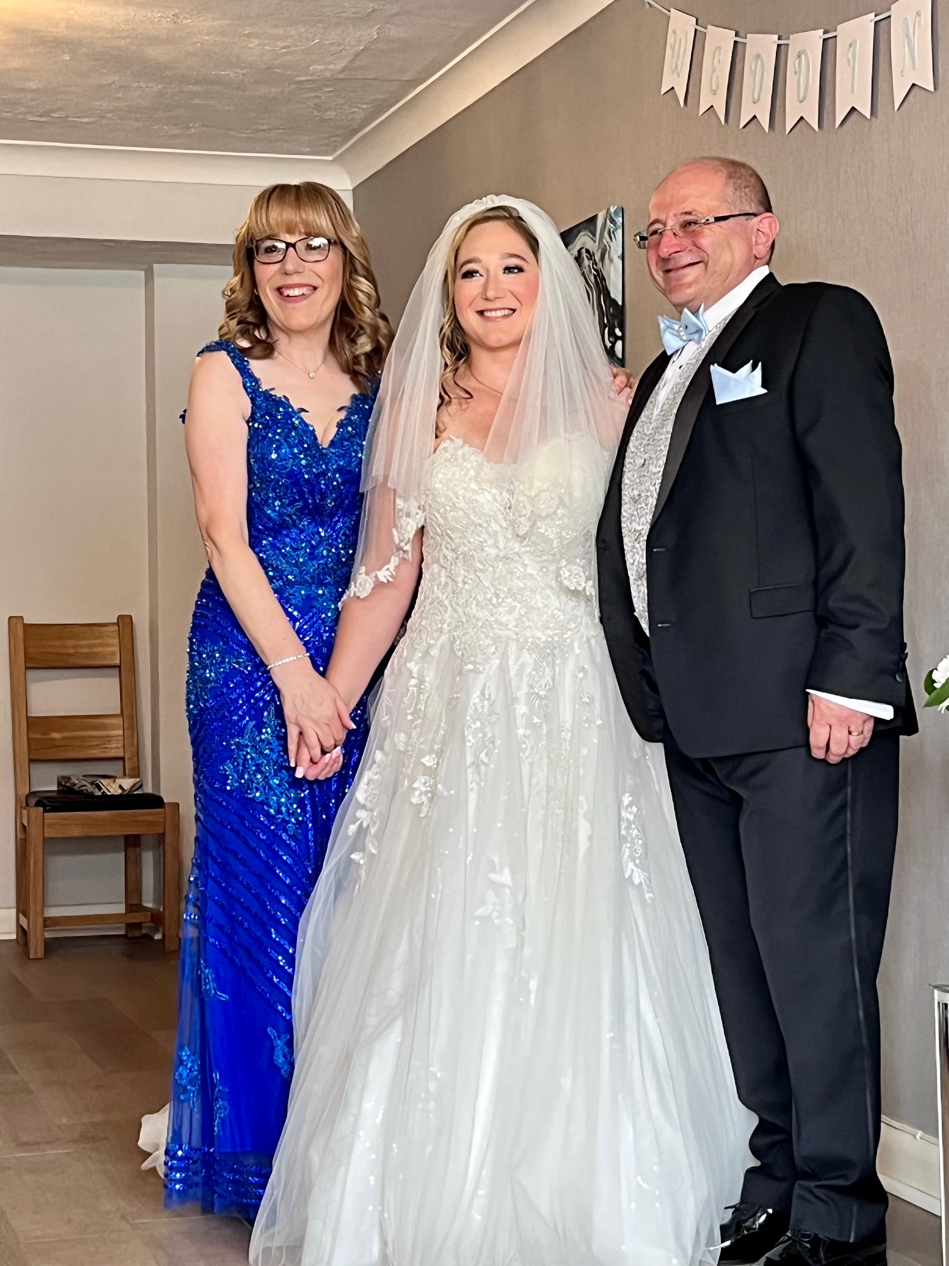
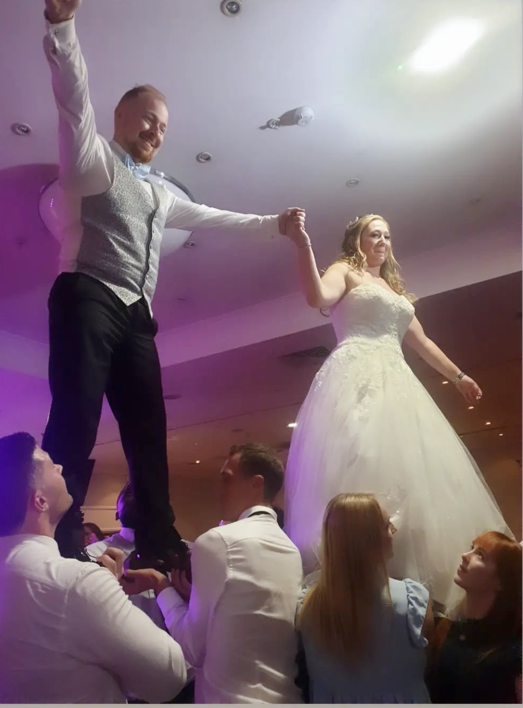

Slide 25
Another story
Awful Pain
No Diagnoses
Labelled as ‘functional’ and …….
Dad really worried – discusses with family member
  Used Entenox
……….presents to A/E

Slide 26


Slide 27
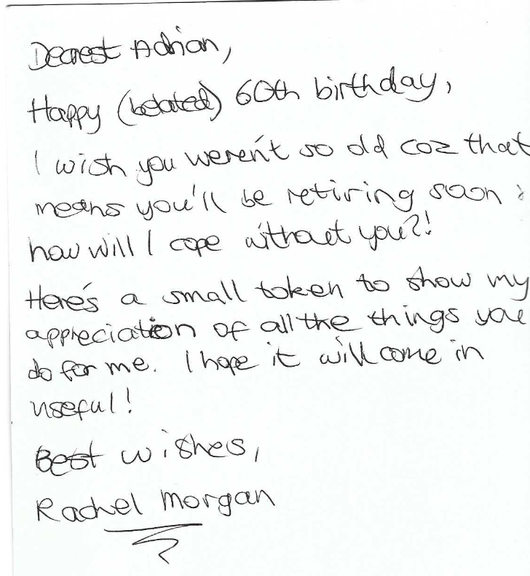

Slide 28
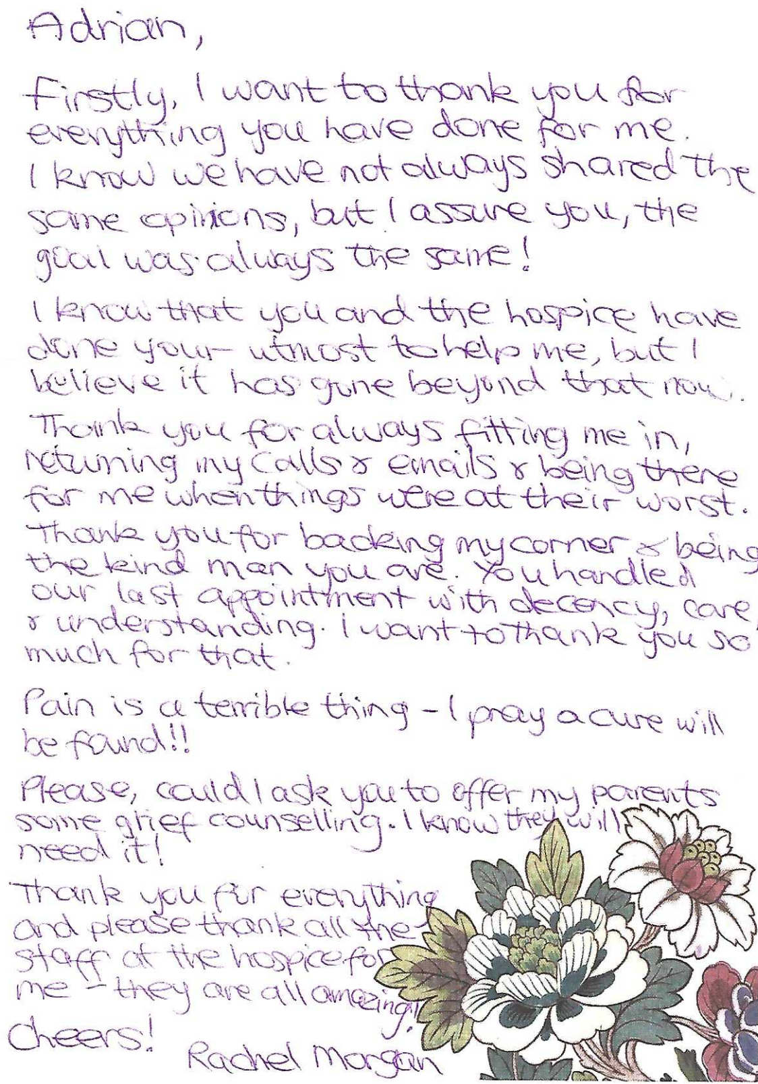

Slide 29
So please help us to help…….
We need to
Think ‘out of the box’
Look at ways of supporting and signposting to the optimal resources

