Slide 1

Building on what Adrian has said….
Forgotten Patients, Overlooked Diseases
(Charity registration: 1202442)
www,forgottenpatients.org

Slide 2
Children versus adults
50%of rare disease patients remain undiagnosed even in advanced diagnostic settings.
Screening in utero and at birth will pick up some of the better-known genetic and acquired diseases which, depending on penetrance, can lead to overt symptoms.
Children may be diagnosed in their early years due to physical and developmental abnormities.
The paediatric population is usually well served by interested physicians, meaning that some 70% of undiagnosed diseases are first recognised in childhood.
By comparison, those in later life experiencing chronic and often complex multiorgan symptoms, notably pain, have no dedicated specialist to turn to as they attempt to navigate a fragmented system (Figure).

Slide 4
Features of PPS
PPS encompass a spectrum, from mild and transient to severe and persistent with varying degrees of functional impairment and health care utilisation.
Common features in adults may include persistent/intermittent muscle pain, abdominal symptoms, back or chest pain, dizziness, palpitations, tiredness and headaches, for which clinical examination and investigations have failed to find a cause.
These features are more than the vague aches, pains and snuffles most of us occasionally experience.
While women are more frequent presenters, all ages can be affected and can present differently.
This is a global issue and left unchecked can signify life-threatening disease or permanent impairment.

Slide 5
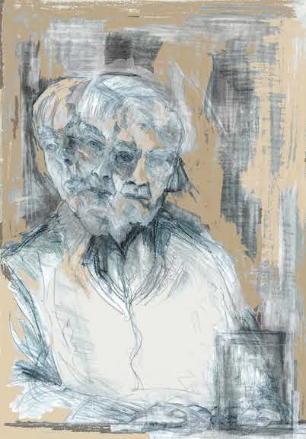
The problem of terminology
Medically Unexplained Symptoms (MUS) and Persistent Physical Symptoms (PPS) are both widely employed.
Because MUS lacks insight into the cause, duration, severity or significance of symptoms, PPS is now preferred.
Many HCPs regard it to be synonymous with Persistent Somatic Symptoms (PSS), but ‘somatic’ can suggest their symptoms are ‘all in the mind’.
Members of the Witte Raven, a Dutch group of interested physicians, propose: Unbearable Unexplained Symptoms (UUS). This describes a sense of unease and helplessness on behalf of the physician faced with a patient who repeatedly presents with serious complaints, but for whom no cause can be found.
Speciality-specific diagnoses may also be considered to come under the PPS umbrella e.g. irritable bowel syndrome.
For patients whose response to their symptoms is characterised by excessive and/or abnormal thoughts, feelings and behaviours the term ‘Somatic Symptom Disorder’ (SSD) is commonly used.
Mental health comorbidity is common in those experiencing PPS, with around 50% suffering from associated anxiety or depression(8).

Slide 6
Coding for ‘I have no idea what is wrong with you’ and reimbursement
There is no universally agreed code. May prevent accurate data collection, access to research and prevent reimbursement in insurance system
Unspecified WHO ICD-10 code R69 for “Symptoms, signs and abnormal clinical and laboratory findings, not elsewhere classified.”
In 2022, the Orphanet classification introduced the code ORPHA:616874 “Rare disorder without a determined diagnosis after full investigation”, increasing the visibility of undiagnosed patients.
Introducing the SNOMED code "Uncertain diagnosis" (Concept ID: 282292002) within primary care records may quantify prevalence and impact (13).

Slide 7
Why are patients experiencing persistent physical symptoms (1)?
Often a combination of factors including
Undiagnosed ‘organic disease’,
Something ‘unknown’ or ‘rare’,
Unusual presentation of a well-recognised pathology,
‘Mental health disorders’
Iatrogenic causation is often unrecognised.
Current testing may be insufficient for diagnosis.
In some patients the original stimulus may have resolved, yet their symptoms persist.

Slide 8
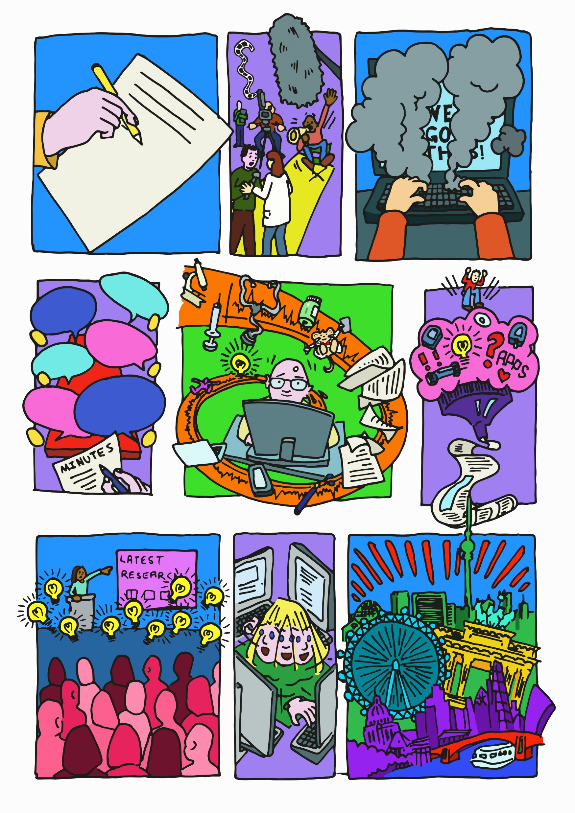
Why are patients experiencing persistent physical symptoms (2)?
The importance of central brain mechanisms, psychosocial factors, childhood adversity, and transgenerational effects are increasingly recognised and may offer an explanation for many with PPS rather than a physical diagnosis.
Pathophysiological links to PPS include low grade inflammation, ‘imbalance’ of the autonomic nervous system and microbiome, genetic and epigenetic changes, and altered interoception.
Interrelationships between psychological, social and physical states are often complex.

Slide 9



The effects of disbelief and gaslighting on people with persistent physical symptoms; a narrative review
1938
1940
1944
Gaslighting is the manipulation of someone into questioning their perception of reality. Medical gaslighting can be described as when health care professionals appear to invalidate or ignore patients’ concerns.

Slide 10
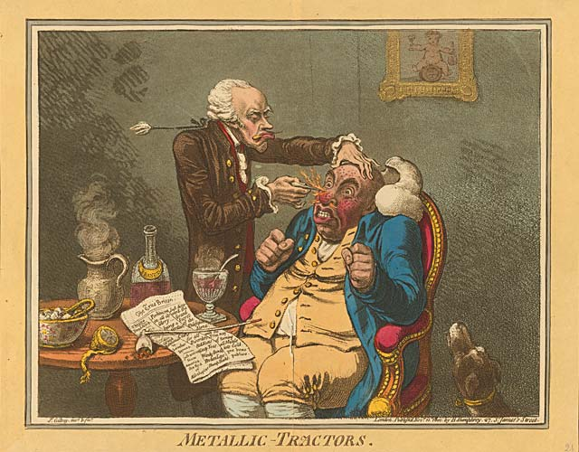
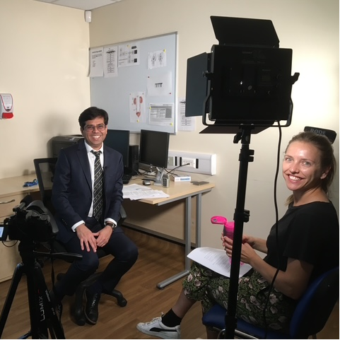
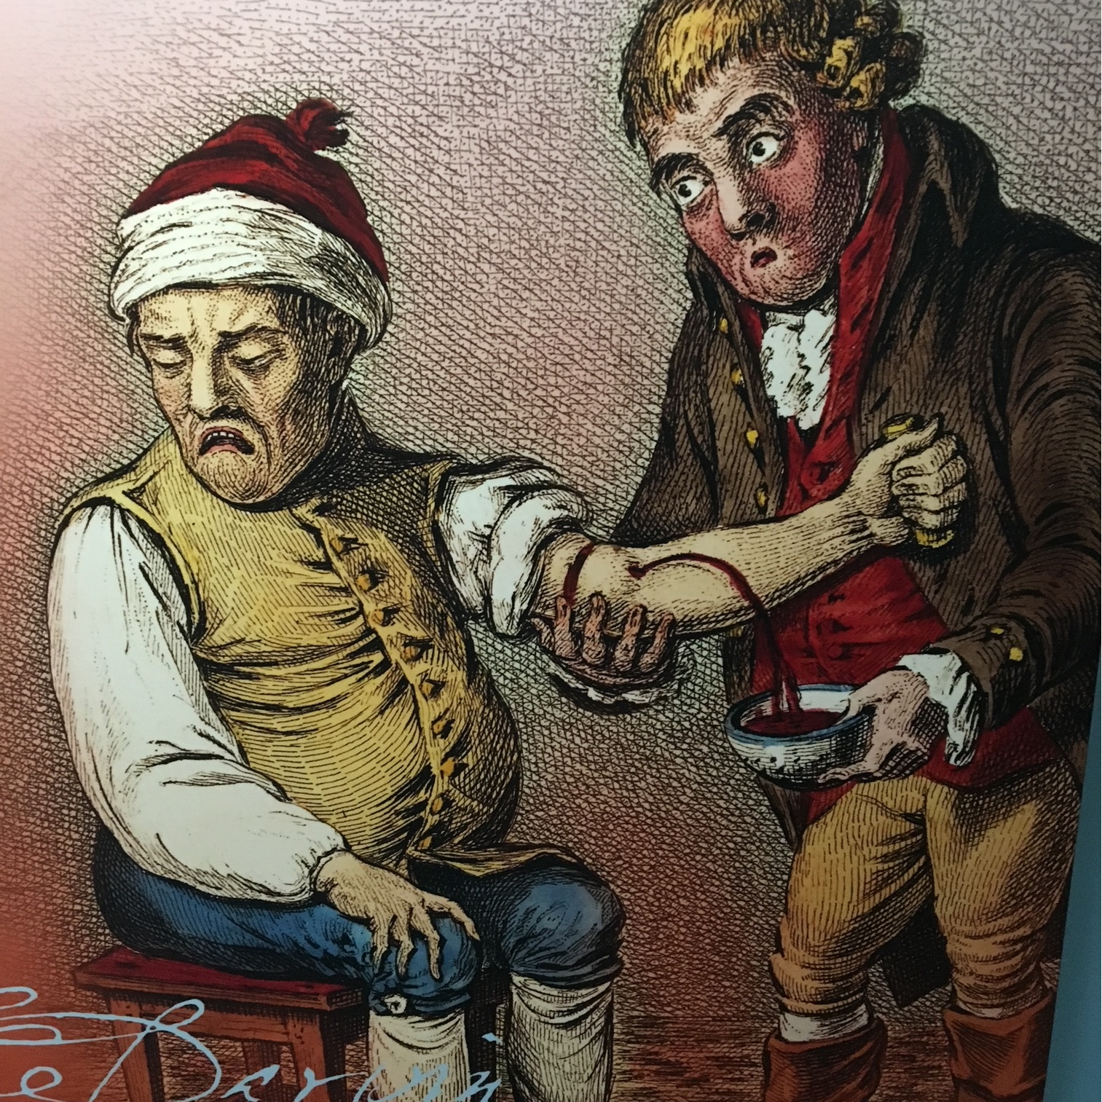
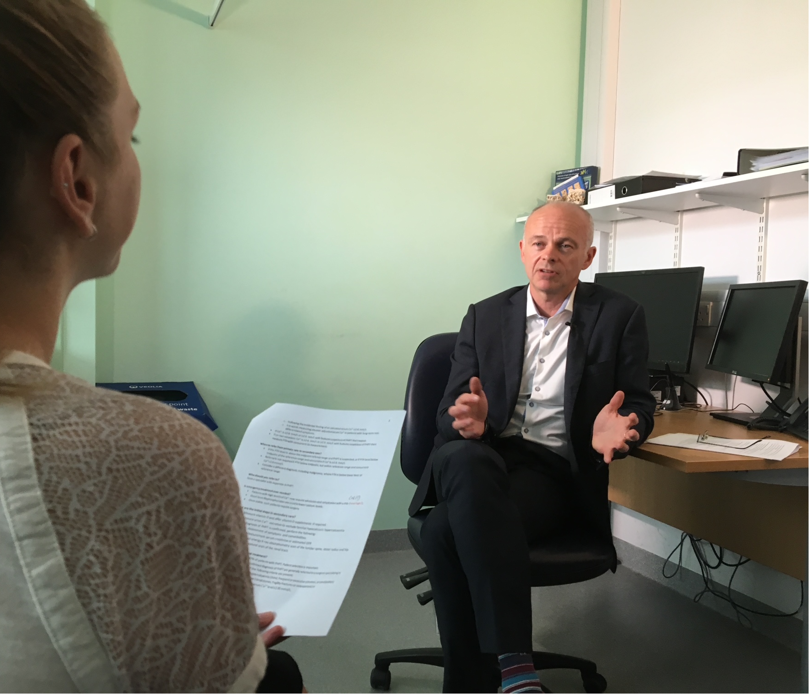
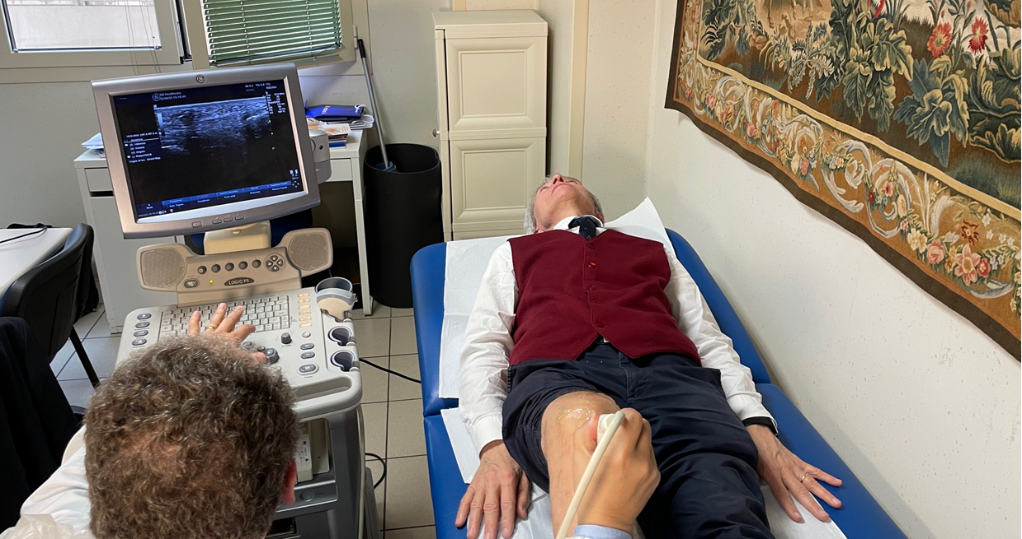
Let us be clear: most medical consultations go well, and patients are satisfied¹.
1.Kabatooro A, Ndoboli F, Namatovu J. Patient satisfaction with medical consultations among adults attending Mulago hospital assessment centre. S Afr Fam Pract (2004). 2016;58(3):87-93.

Slide 11


So why conduct a study?
Anecdotal evidence suggests that gaslighting, disbelief or invalidation
Occurs in healthcare
Experiences of others resonate with patients
May negatively affect the consultation
Can have health consequences
Relevant to the interests of our charity
A topic sometimes touched on by health journalist – requires scientific rigour
Systematic review registration: https://www.crd.york.ac.uk/PROSPERO/view/CRD42024601930.

Slide 12
Systematic review: summary of outcomes strategy for data synthesis
What we are looking at: physical, psychological wellbeing and mental health (anxiety, depression); quality of life, ability to work, financial effects. Also, standardised measures of common mental disorders and quality of life. Effects on family, close person and carer network
Locations: primary care, general practice, secondary care, hospital
Methodology: A thematic synthesis using a step-by-step process. This will involve detailed study of qualitative findings using framework analysis (Ritchie and Lewis) to identify emergent themes. This will include consideration of context, quotes, reported themes, interpretations and discussion.
Thematic synthesis of sub-groups in related areas e.g., relationships, employment, financial challenges and effects of misdiagnosis

Slide 13

Databases and summary of search terms
Databases
PubMed, Embase, Cochrane, APA PsycINFO, Emcare, Web of Science, Scopus as well as available grey literature.
Summary of search terms
Primary care, general practice, secondary care, hospital,
persistent symptoms, medically unexplained symptoms, medical gaslighting, patient dismissal, disbelief/disbelieved,
health outcomes, mental health, depression, anxiety, psychosomatic, hysteria, chronic fatigue.
disbelief or disbeliev* or gaslight* or sceptic* or dismiss*

Slide 14

PRISMA Gaslighting
2839 references imported for screening as 2839 studies
18 duplicates identified manually
895 duplicates identified by Covidence
1926 studies screened against title and abstract
1720 studies excluded
182 studies assessed for full-text eligibility
111 studies excluded
94 wrong topic/not relevant gaslighting
7 paper not available/found
4 only abstract available
3 not peer-reviewed (abstract, poster)
2 paper not in english
1 Wrong patient population
0 studies ongoing
0 studies awaiting classification
71 studies included
Embase (n = 769)
Web of Science (n = 576)
Scopus (n = 368)
PsycINFO (n = 199)

Slide 15
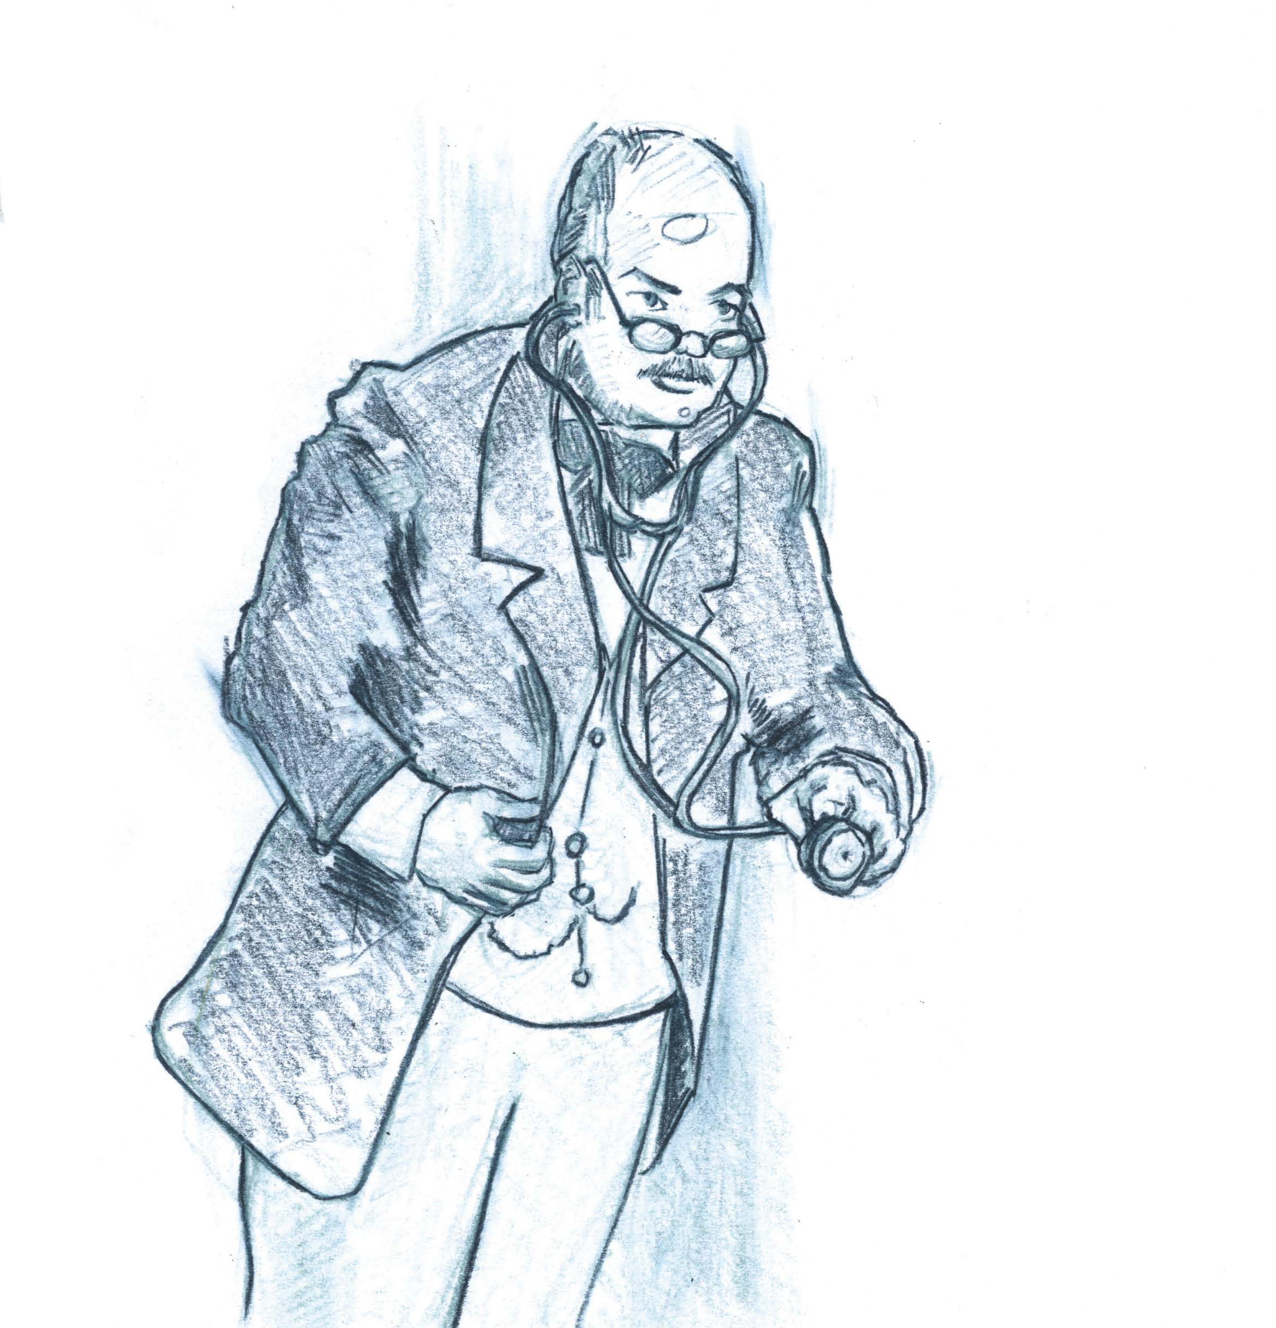
What diseases/situations were examined?
Diverse including:
Medically unexplained symptoms
Chronic fatigue syndrome
Chronic disease e.g. endometriosis, fibromyalgia in female veterans, black orthopaedic patients experiencing microaggression
Genetic: inherited bleeding disorders
Psychological/mental illness
Female experiences e.g. post natal depression
Male experiences
Long COVID
Comorbidities
Racism/racial minorities/racial discrimination

Slide 16

Which patients are more at risk?
No quantitative studies
A global problem
Women
Poor communication
Mental health
Race and ethnicity: Blacks and Hispanics
Lower caste women in India and Pakistan
Transgender and sexual minorities
Substance abuse
Question: Are male doctors more likely to dismiss symptoms in women?

Slide 17
Unhelpful responses in the consultation
“All your tests are normal”
“Hormonal imbalance”
“All in your head”
“You are too young” to be experiencing….
“Your symptoms will get better with age”
Blaming e.g. overweight
Undermining and normalising symptoms e.g. “pain is to be expected in childbirth, “Babies do cry”

Slide 18
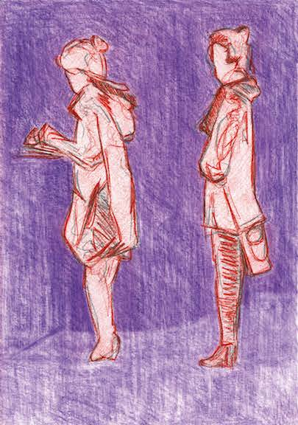
Impact of gaslighting
Denial, objectification, discounted and dismissal of symptoms “made women feel they were being told ‘shut‑up”
‘Psychologically invalidated’ – victim and abuser
Less comfortable sharing problems and more sceptical when it comes to treatment options
Delayed diagnosis e.g. in women with nephrogenic systemic fibrosis
Poorer pain control
Stop seeking a diagnosis
Negative experience of healthcare professionals
Disrespect. Lack of empathy. Accusations of malingering
Need for self-advocacy
Stigmatisation of mental health
Anxiety, vulnerability and trauma
Unnecessary medication e.g. anti-depressants

Slide 19
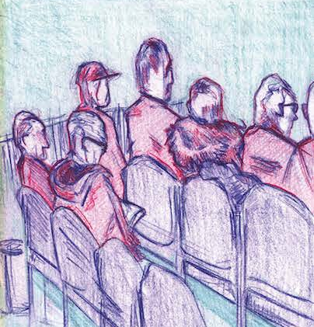
It is not just the patient that is affected
Health professionals can be confused by the way some patients present their story .
Tensions are created when patients have experienced previous unsatisfactory consultations. This can lead patients to be defensive or to present complicated stories with emotion or frustration.
Rushed consultations can also mean that patients feel unable to communicate the full extent or context of their condition.
GPs can experience a lack of control in the consultation and the inability to provide a biomedical diagnosis and prescribe medication can lead to a sense of powerlessness and frustration.
If a patient does not improve, practice nurses and GPs also report a lack of job satisfaction and can distance themselves from the patient.
The breakdown of the GP-patient relationship can lead to a lack of empathetic care and patients can feel helpless and let down.

Slide 20

Final comments
Most consultations go well
Gaslighting is a problem, but we don’t know how big and when it typically occurs
Effects often hidden
It can affect health outcomes
Poor communication on the part of all stakeholders is a significant contributor
Validation of symptoms and giving permission to speak are key factors in avoiding gaslighting
More /better quality research is needed.

Slide 21

Summary 1
Without a diagnosis, life is hard. PPS are common, often complex, and diverse. They are associated with distress, mental deterioration, and a widely unappreciated socioeconomic burden on individuals, families, and society.
Patients may experience cycles of tests, referrals, and unsuccessful attempts at treatment. Common experiences are delay, disbelief, and a lack of empathy. Obtaining a diagnosis, even in the absence of a cure, can bring relief and hope.
Managing patients with PPS is challenging because of frequent attendance, time pressure, limited knowledge and resources and siloed working compounded by a lack of general physicians.

Slide 22

Summary 2
The problem of PPS deserves greater awareness, research, and resource.
Patients may be helped by unhurried consultations, continuity of care, early genetic testing, and empathetic curiosity, supplemented by diagnostic aids, management algorithms, and ready access to multi-disciplinary teams and specialist clinics.
Talking therapies, trials of medications and support groups have a role where a diagnosis cannot be established, or symptoms persist.
steven.walker@forgottenpatients.org

