Slide 1
A researcher’s view
Chris Burton, Professor of Primary Medical Care
chris.burton@sheffield.ac.uk

Slide 2
About me
Graduated 1982, one lecture on “psychosomatic medicine” - including migraine and peptic ulcer.
GP partner 1986-2012, Post-industrial semi-rural community, sessional GP 2013-24
MD 2006, Clinical Academic posts since 2012
Research
Hyperventilation / dysfunctional breathing 1991
Challenging psychogenic model of “MUS” 2006
Effectiveness of talking interventions for MUS 2010
Explanation for persistent symptoms 2016
Symptoms Clinic trial 2024
Views are my own. No conflicts of interest

Slide 3
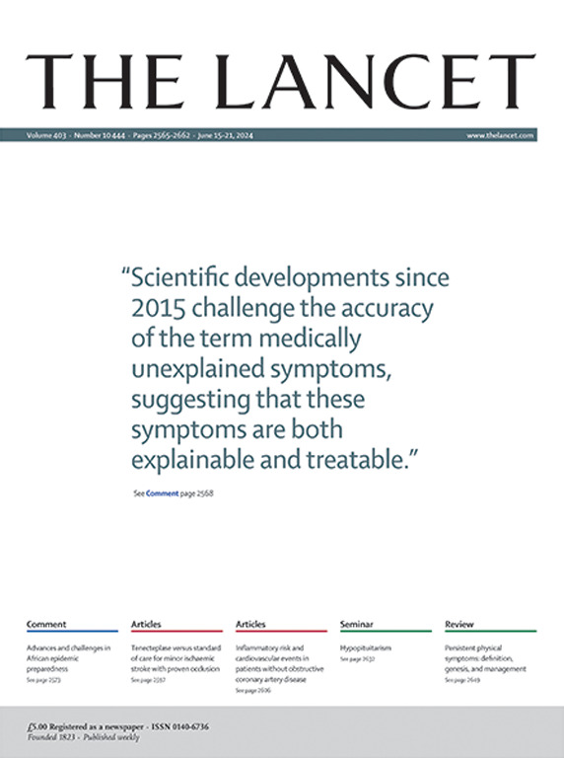
A challenge

Slide 4
Why the dreadful terminology?
17thC Descartes - dualism
19thC Parisian Neurology, Freud, hysteria
Mid 20thC Biopsychosocial - integrated
Late20thC “Medically unexplained” as middle way
New science of symptoms (starting with chronic pain)

Slide 5
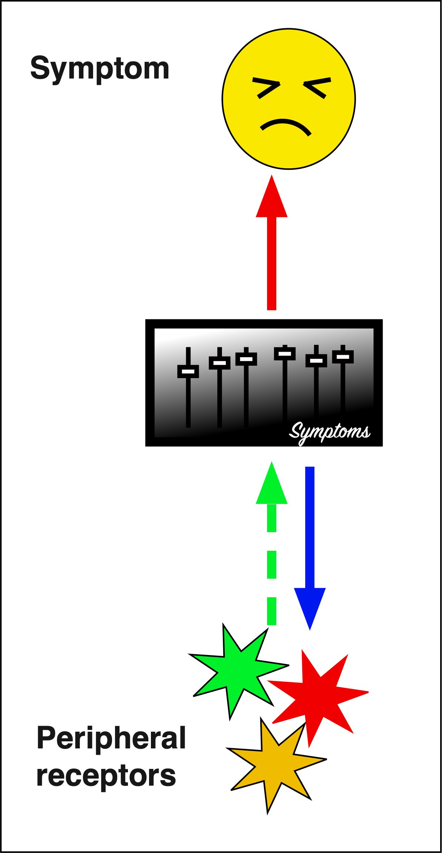
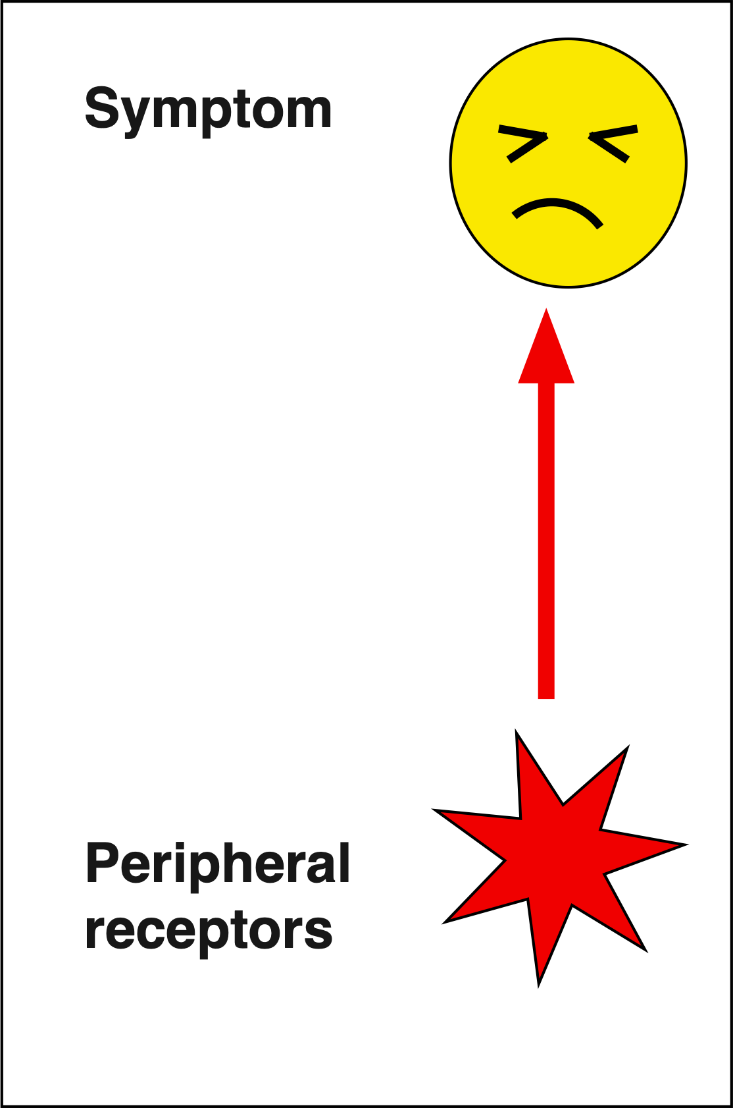


What is a symptom?
A physical sensation indicating actual or threatened disease
When persistent may become an entity rather than a signifier

Slide 6
Persistent Symptoms are associated with things happening in the body
Low grade inflammation
Autonomic nervous system “imbalance”
Changes in microbiome
Genetic and epigenetic changes
Altered interoception

Slide 7
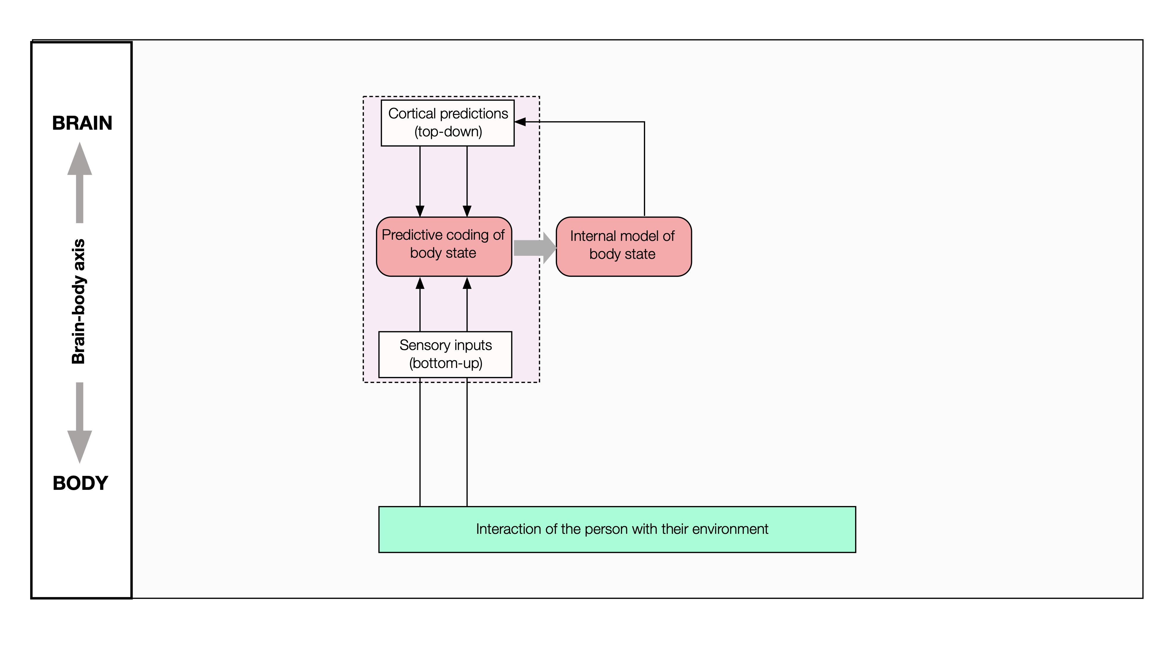
Interoception control loop

Slide 8
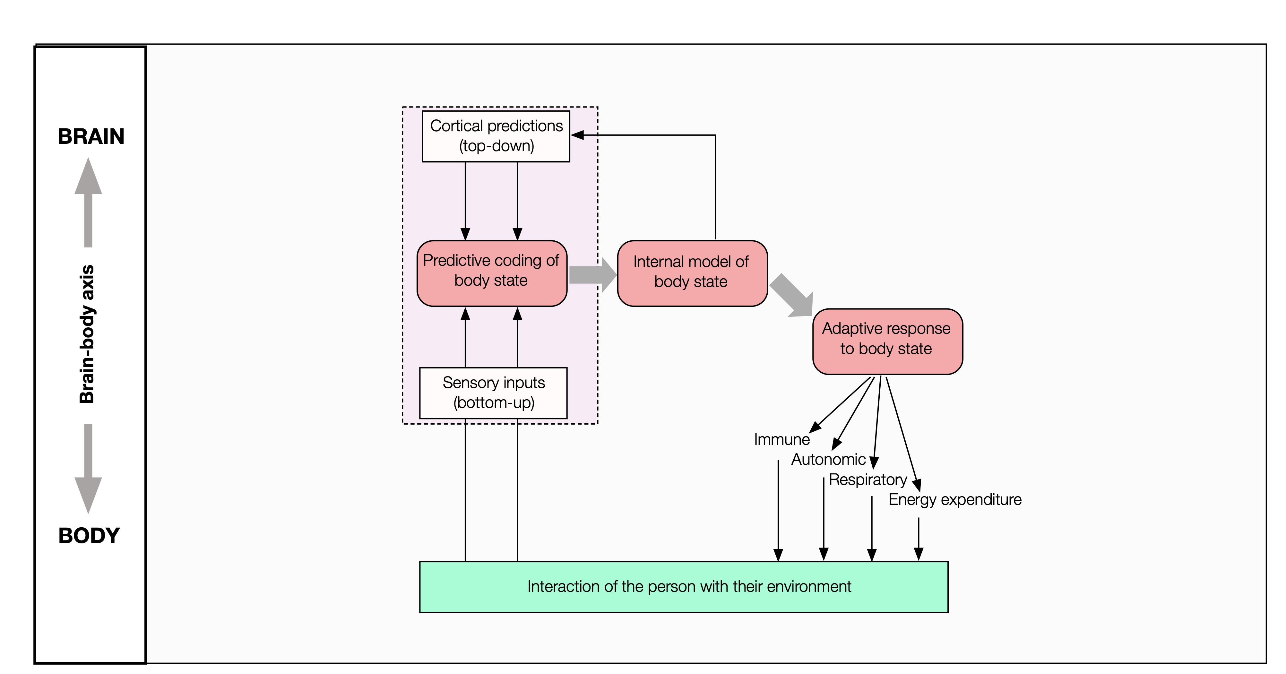
Interoception- allostasis control loop

Slide 9
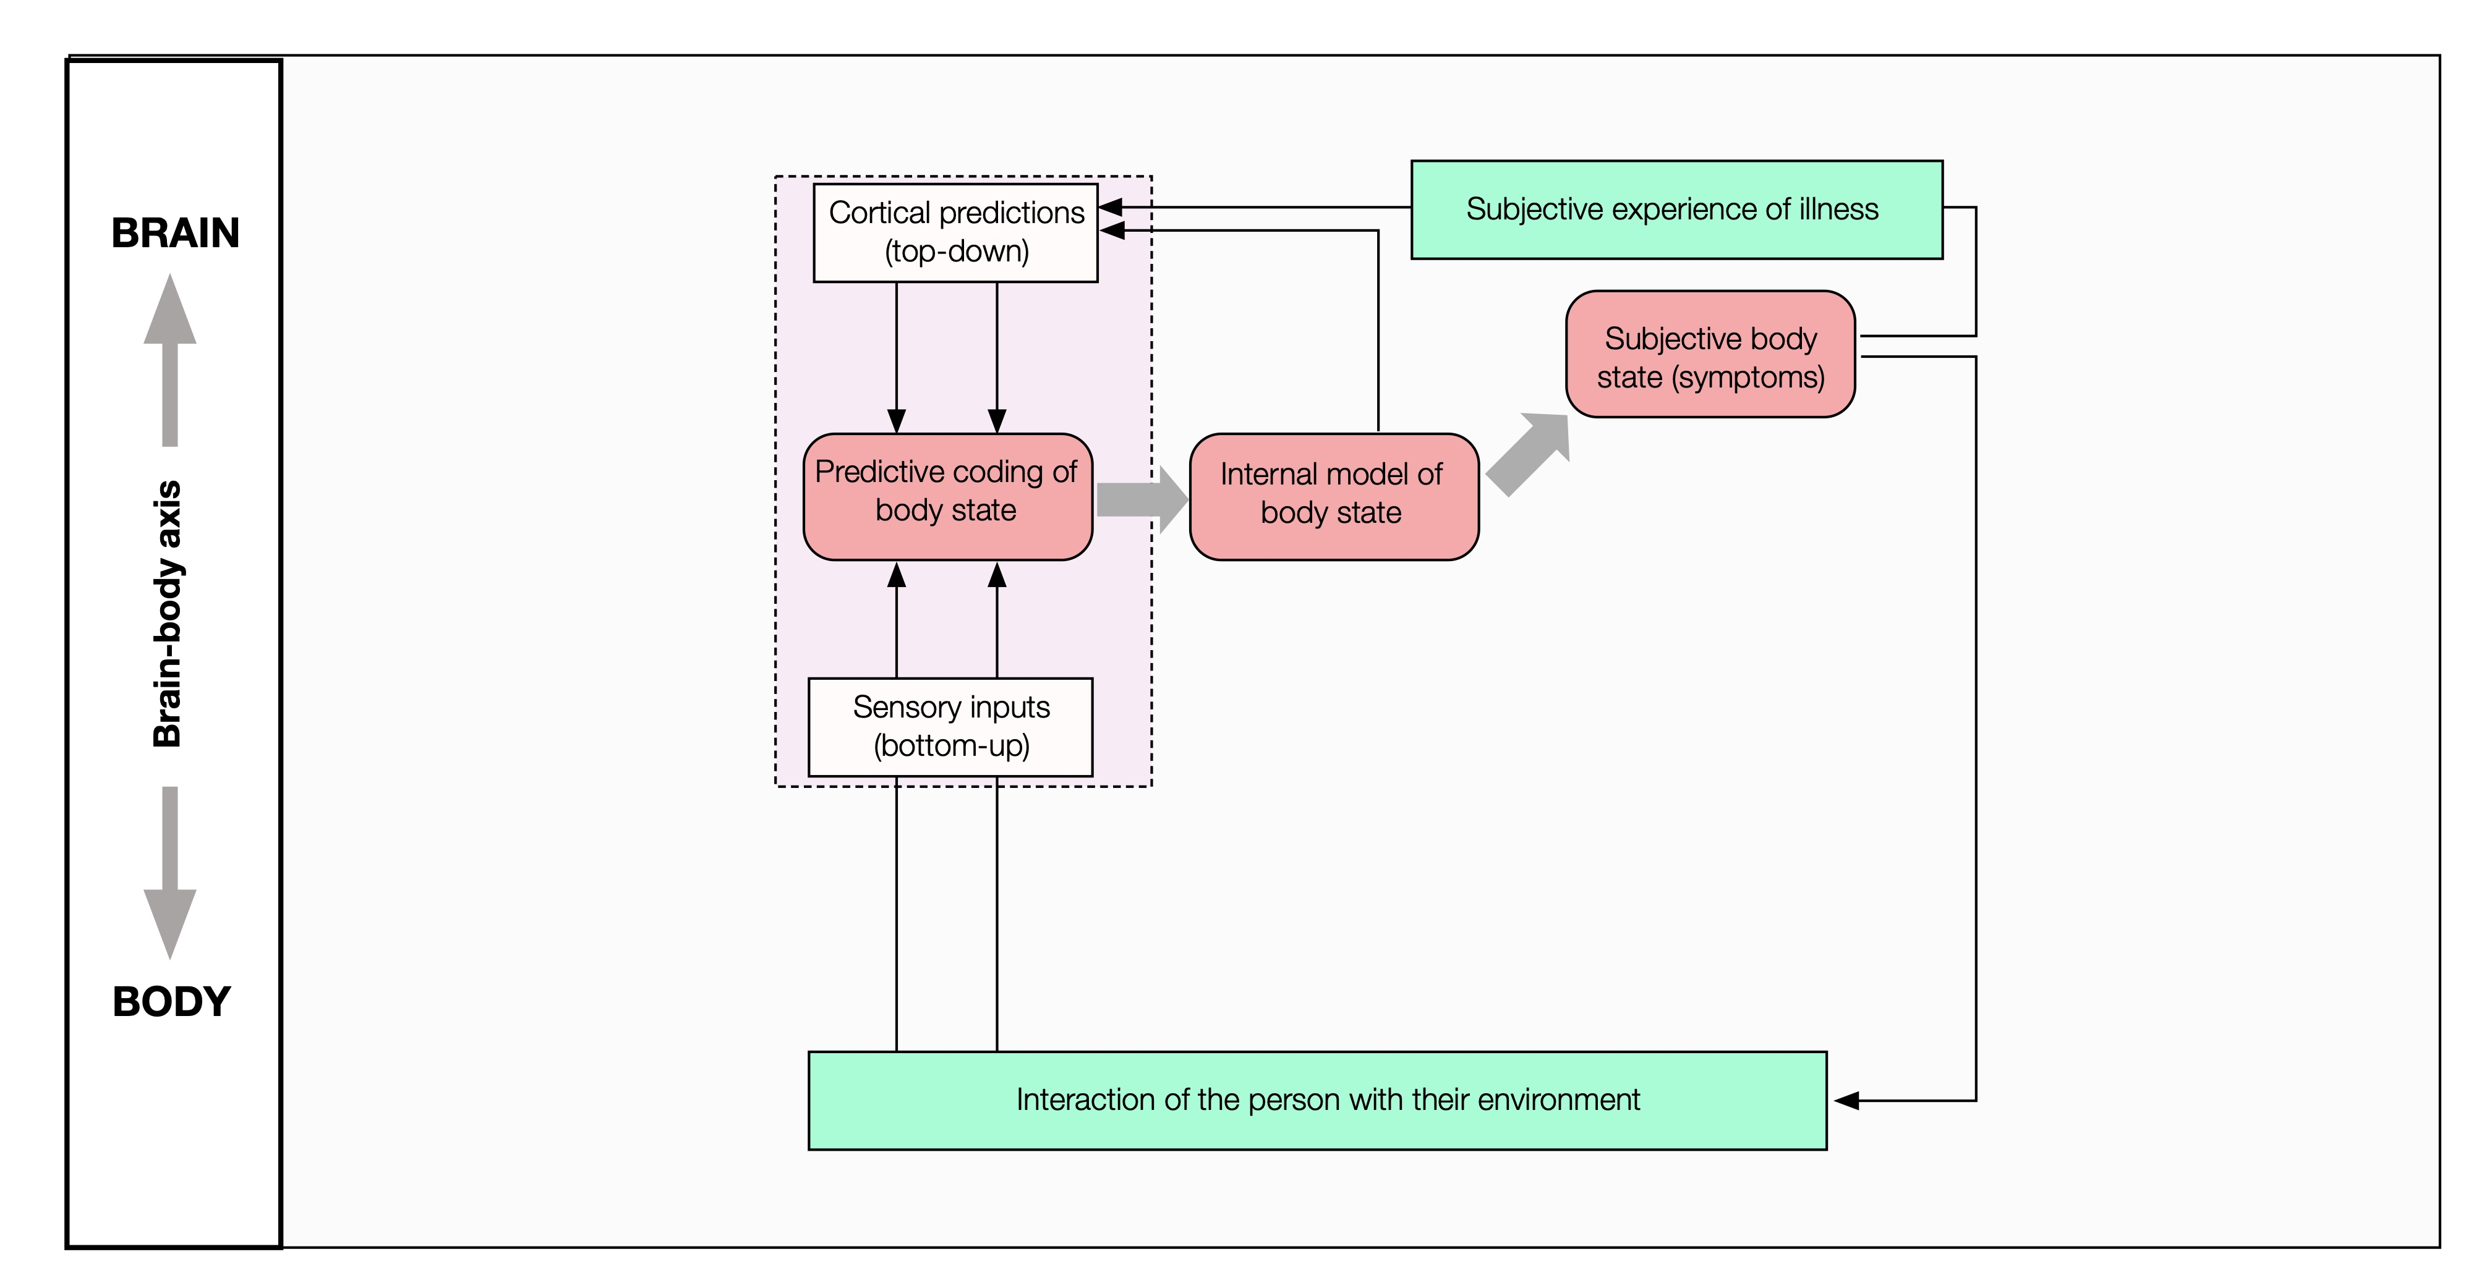
Interoception – perception loop

Slide 10
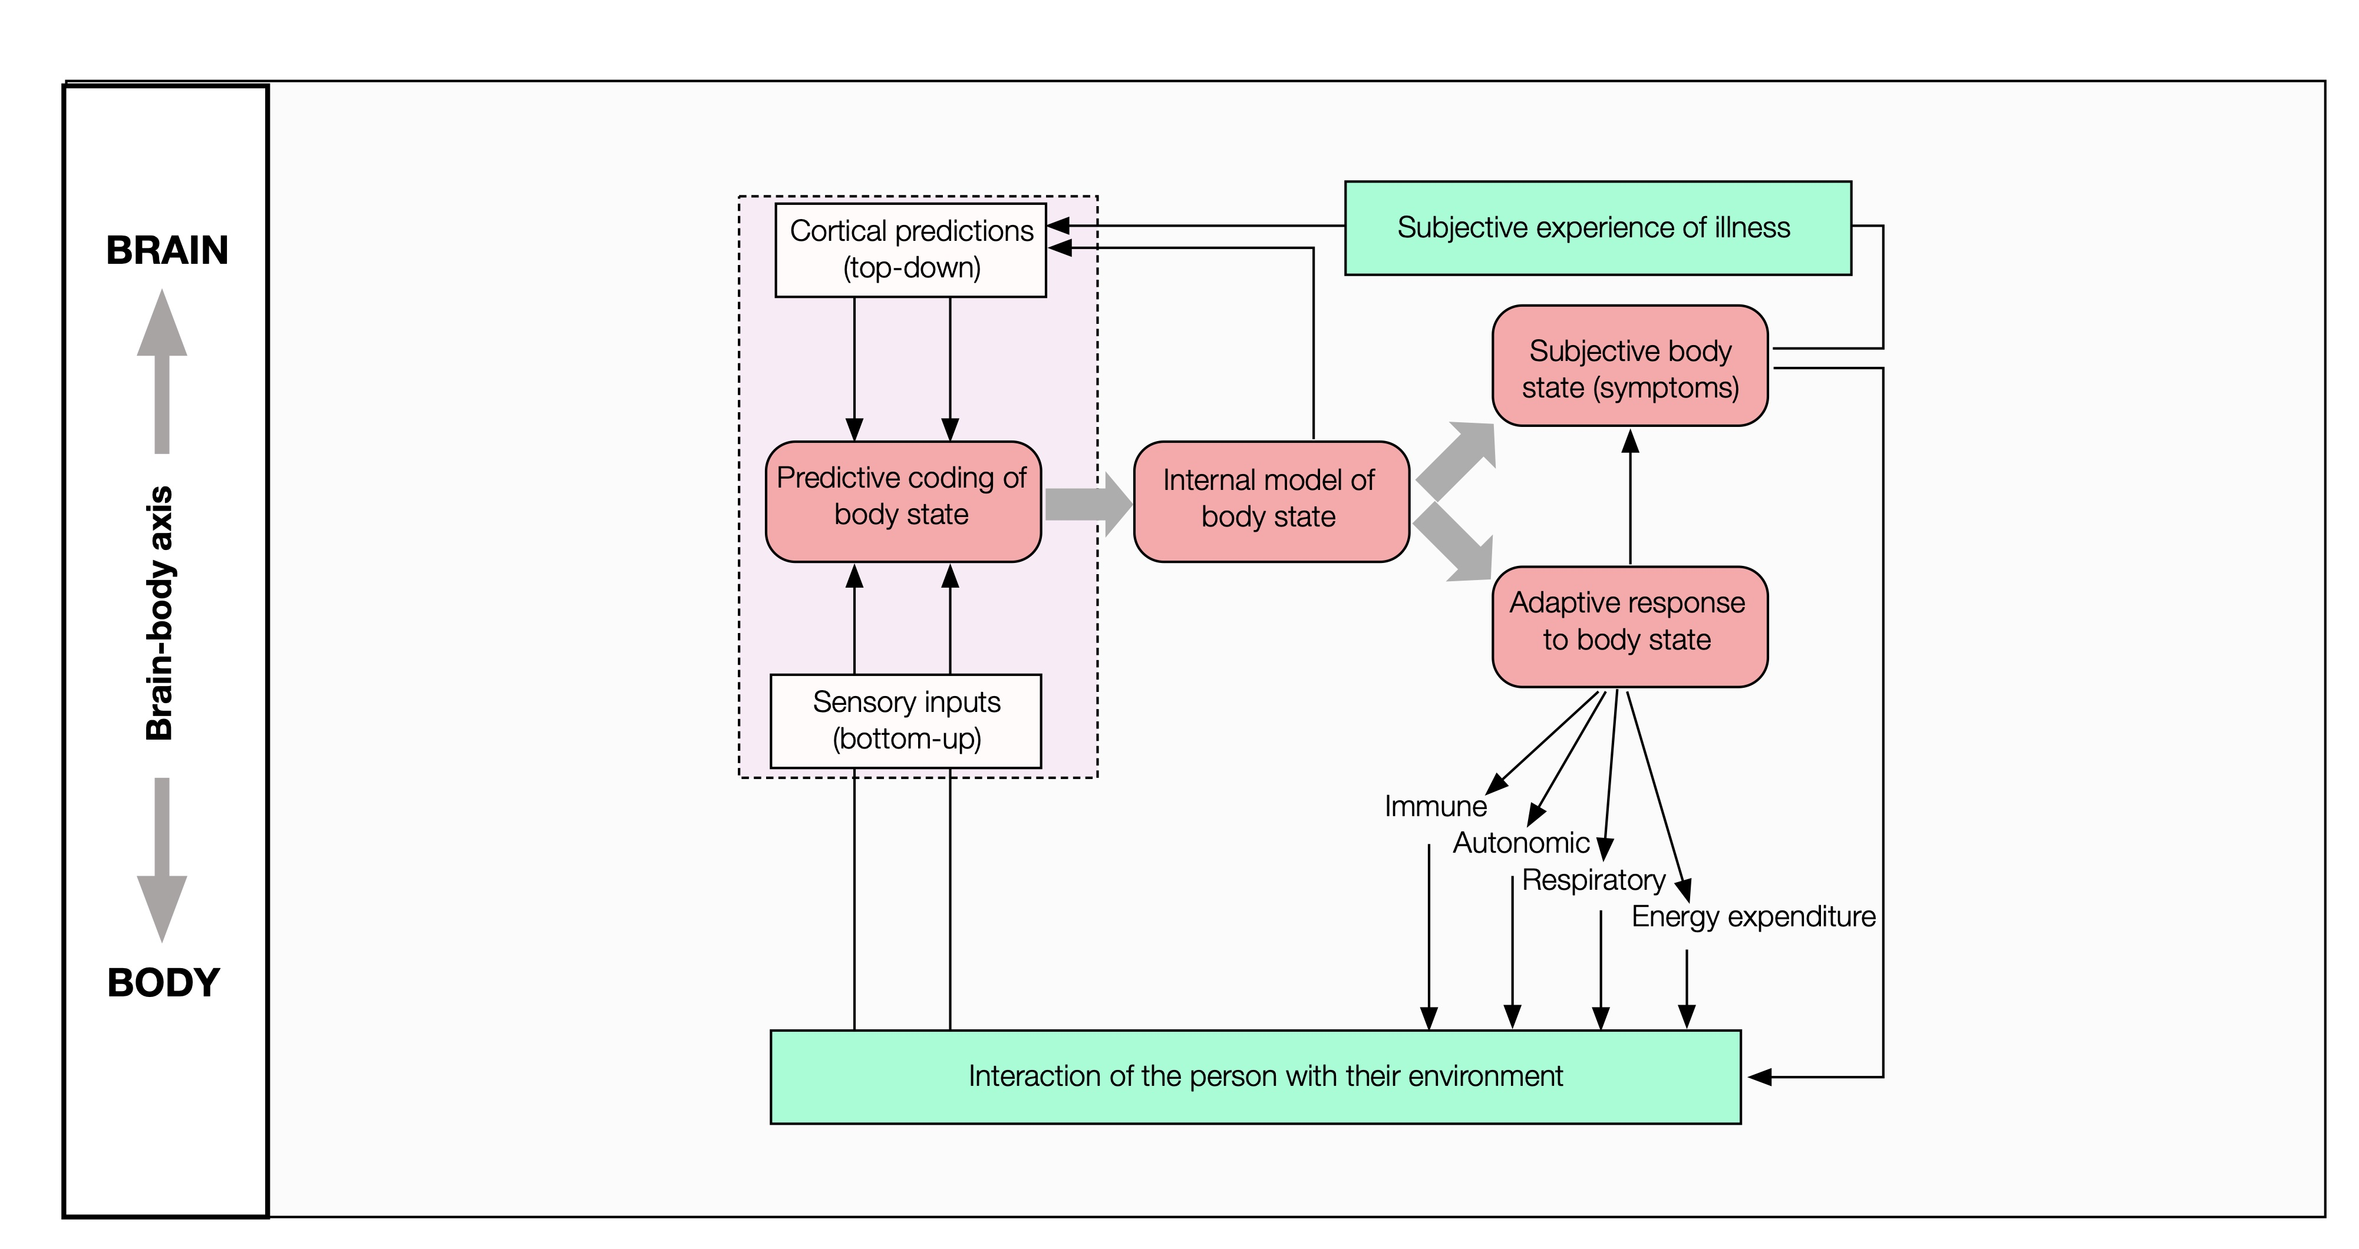
Dual loops

Slide 11
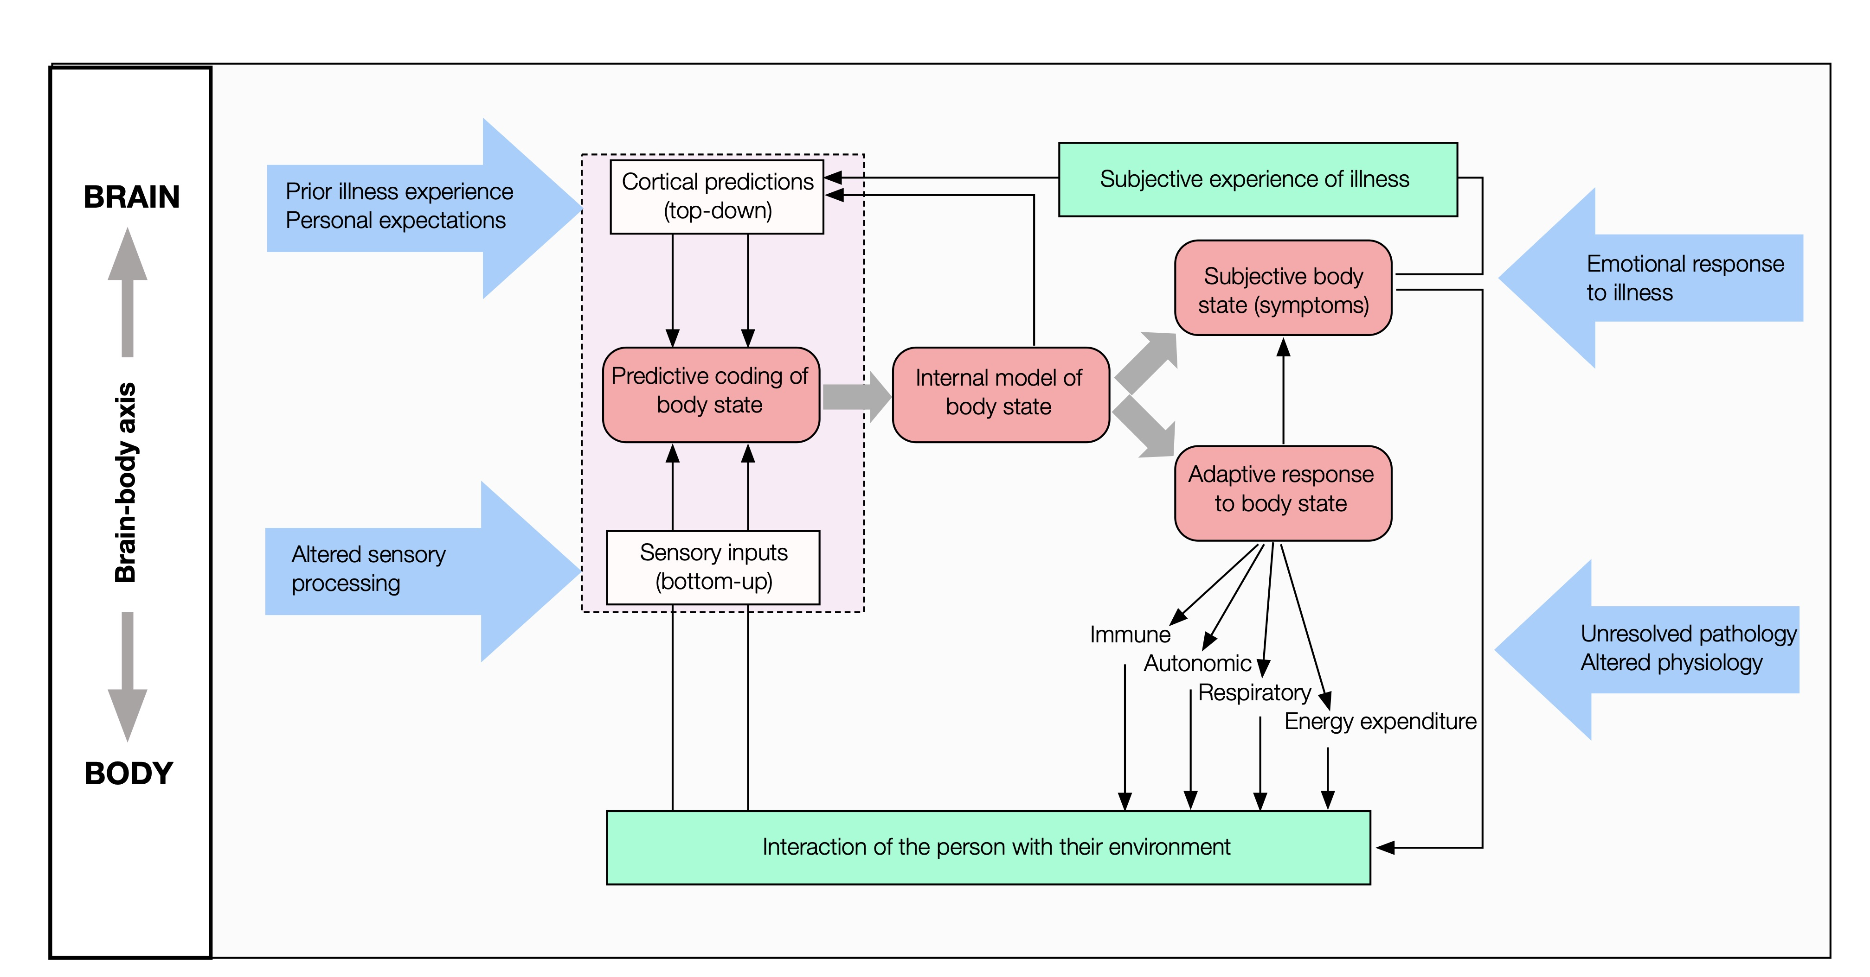
External things come into play too

Slide 12
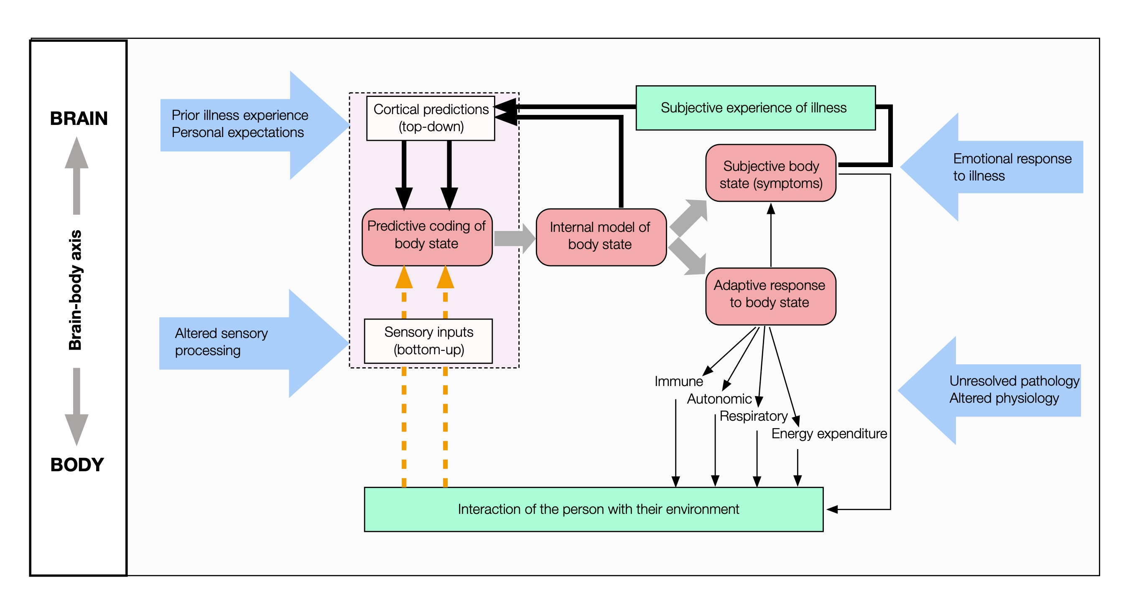
When the system breaks
Dominance of cortical predictions
Persistent physical symptoms
Always-on allostatic signalling
Distortion / loss of interoceptive signals
x

Slide 13
When symptoms are present, but all tests are negative?
Why is it wrong to exclude the body?
Because we will continue to find new things that will explain (part of) what’s going on
Because having risk factors for symptom disorders doesn’t stop you getting cancer
Because sometimes serious illnesses begin in innocuous or atypical ways
Why is it wrong to exclude the brain/ mind?
Increasingly clear that persistent symptoms (like ”chronic pain”) are disorders in their own right
Psychological processes are one of many mechanisms the brain deploys to protect / conserve resources. We are all different: some people are naturally more careful / threat-aware than others
Positive criteria reduce the risk of (mis-)attribution by default

Slide 14
When symptoms are present, but all tests are negative?
Why is it right to hold both?
Causality is complex
Overlaps are common
Diagnosis can be a two-edged sword
Dual mechanisms
20% of people with ”severe” asthma have normal lung function
If all my symptoms are due to X and there is no cure…….
Hypermobility and neurodiversity may reduce accuracy of symptom perception

Slide 15
So what can we do?
Talk about this - dialogue rather than diatribe
Set up clinics – Helsinki Model or REAL
Teach it
Research it - at all levels (and across levels)
Proceed respectfully

Slide 16


Summing up –bright lighting and Occam’s razor
“Plurality must never be posited without necessity”
Geoffrey of Ockham
“Numquam ponenda est pluralitas sine necessitate”
Geoffrey of Ockham
Persistent physical symptoms need “plurality” of thinking, with the brightest possible light turned upon them

