Slide 1
The problems of
Doctor- Patient Bias,
Persona, Gaslighting and Acknowledging Diagnostic Doubt
Why do consultations sometimes not go well??

Slide 2
What is the impact for people who have persistent symptoms with no diagnoses?
Some recognized issues
Issues not acknowledged
Frequent attenders?
Get misdiagnosed?
  Mental health issues
Do not have appropriate management?
Suicidality?
Become angry – IMPACT???
Cease attending their doctor
Impact on family and friends
Seek inappropriate interventions

Slide 3
What is the impact for people who have persistent symptoms with no diagnoses?
Some recognized issues
Issues not acknowledged
Frequent attenders?
Get misdiagnosed?
  Mental health issues
Do not have appropriate management?
Suicidality?
Become angry – IMPACT???
Cease attending their doctor
Impact on family and friends
Seek inappropriate interventions

Slide 4
We also need to address other issues that are not acknowledged

Slide 5
We also need to address other issues that are not acknowledged – examples………
Patient
Personna is important
No exploration re: patient’s attitude in a consultation and its impact on the diagnostic journey
  The angry Patient and its impact on a consultation
  The silent patient

Slide 6
We also need to address what is not acknowledged – examples………
Patient
Doctor
Personna is important
No exploration re: patient’s attitude in a consultation and its impact on the dianostic journey
  The angry Patient and its impact on a consultation
  The silent patient
The ‘assertive’ Doctor
Using tactics that ‘distance’ patients
Misdiagnoses
  Somatic Symptom Disorder?
  Functional?
  Catastrophiser?
  Heartsink etc, etc, etc ……..

Slide 7
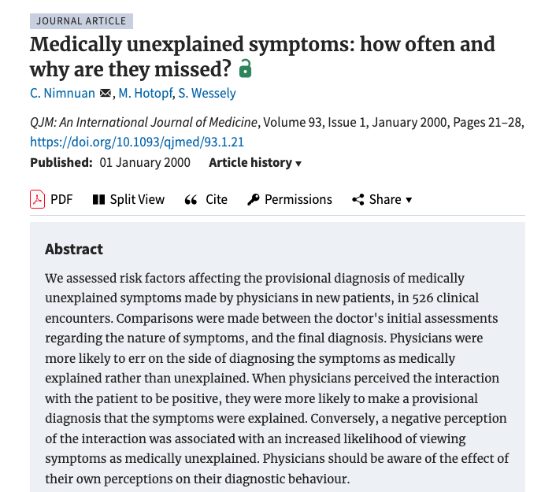
Patient responses/interactions influence doctor’s responses…… be aware that attitude makes a difference

Slide 8
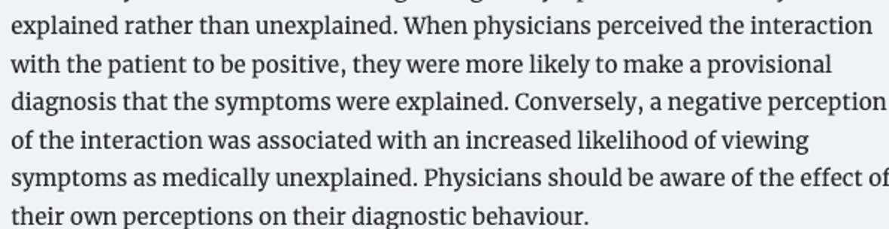

Slide 9
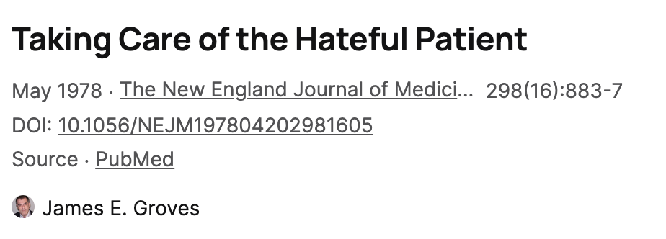
Negative perception????…….

Slide 10
these labels include……
Heartsink
Catastrophiser
Difficult Patient
Dependent clinger
Entitled demander
Manipulative Help Rejecter
Self-destructive denier
???????!!!!

Slide 11
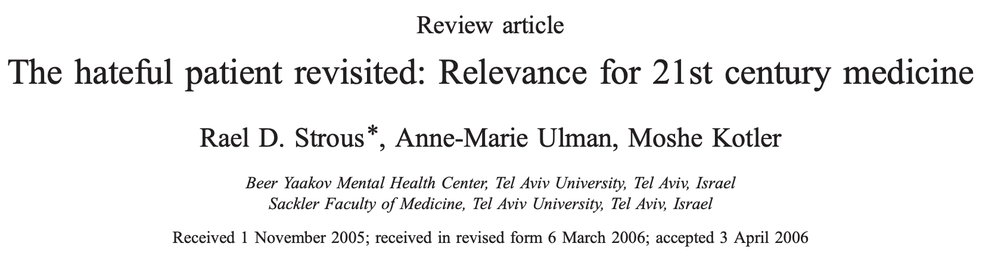

Slide 12
Summary of abstract…….
Importance of doctor-patient relationship
Sensitivity to the phenomenon will lead to improved physician well-being, less self-destructive patient behaviour
Several factors may assist the 21st century physician in managing the “hateful patient” in an empathic manner and in making some sense of why the patient has resorted to negative response patterns.
A failure to consider these issues will result in poorer medical care and, no less important, reduced satisfaction of both patients and doctors.

Slide 14
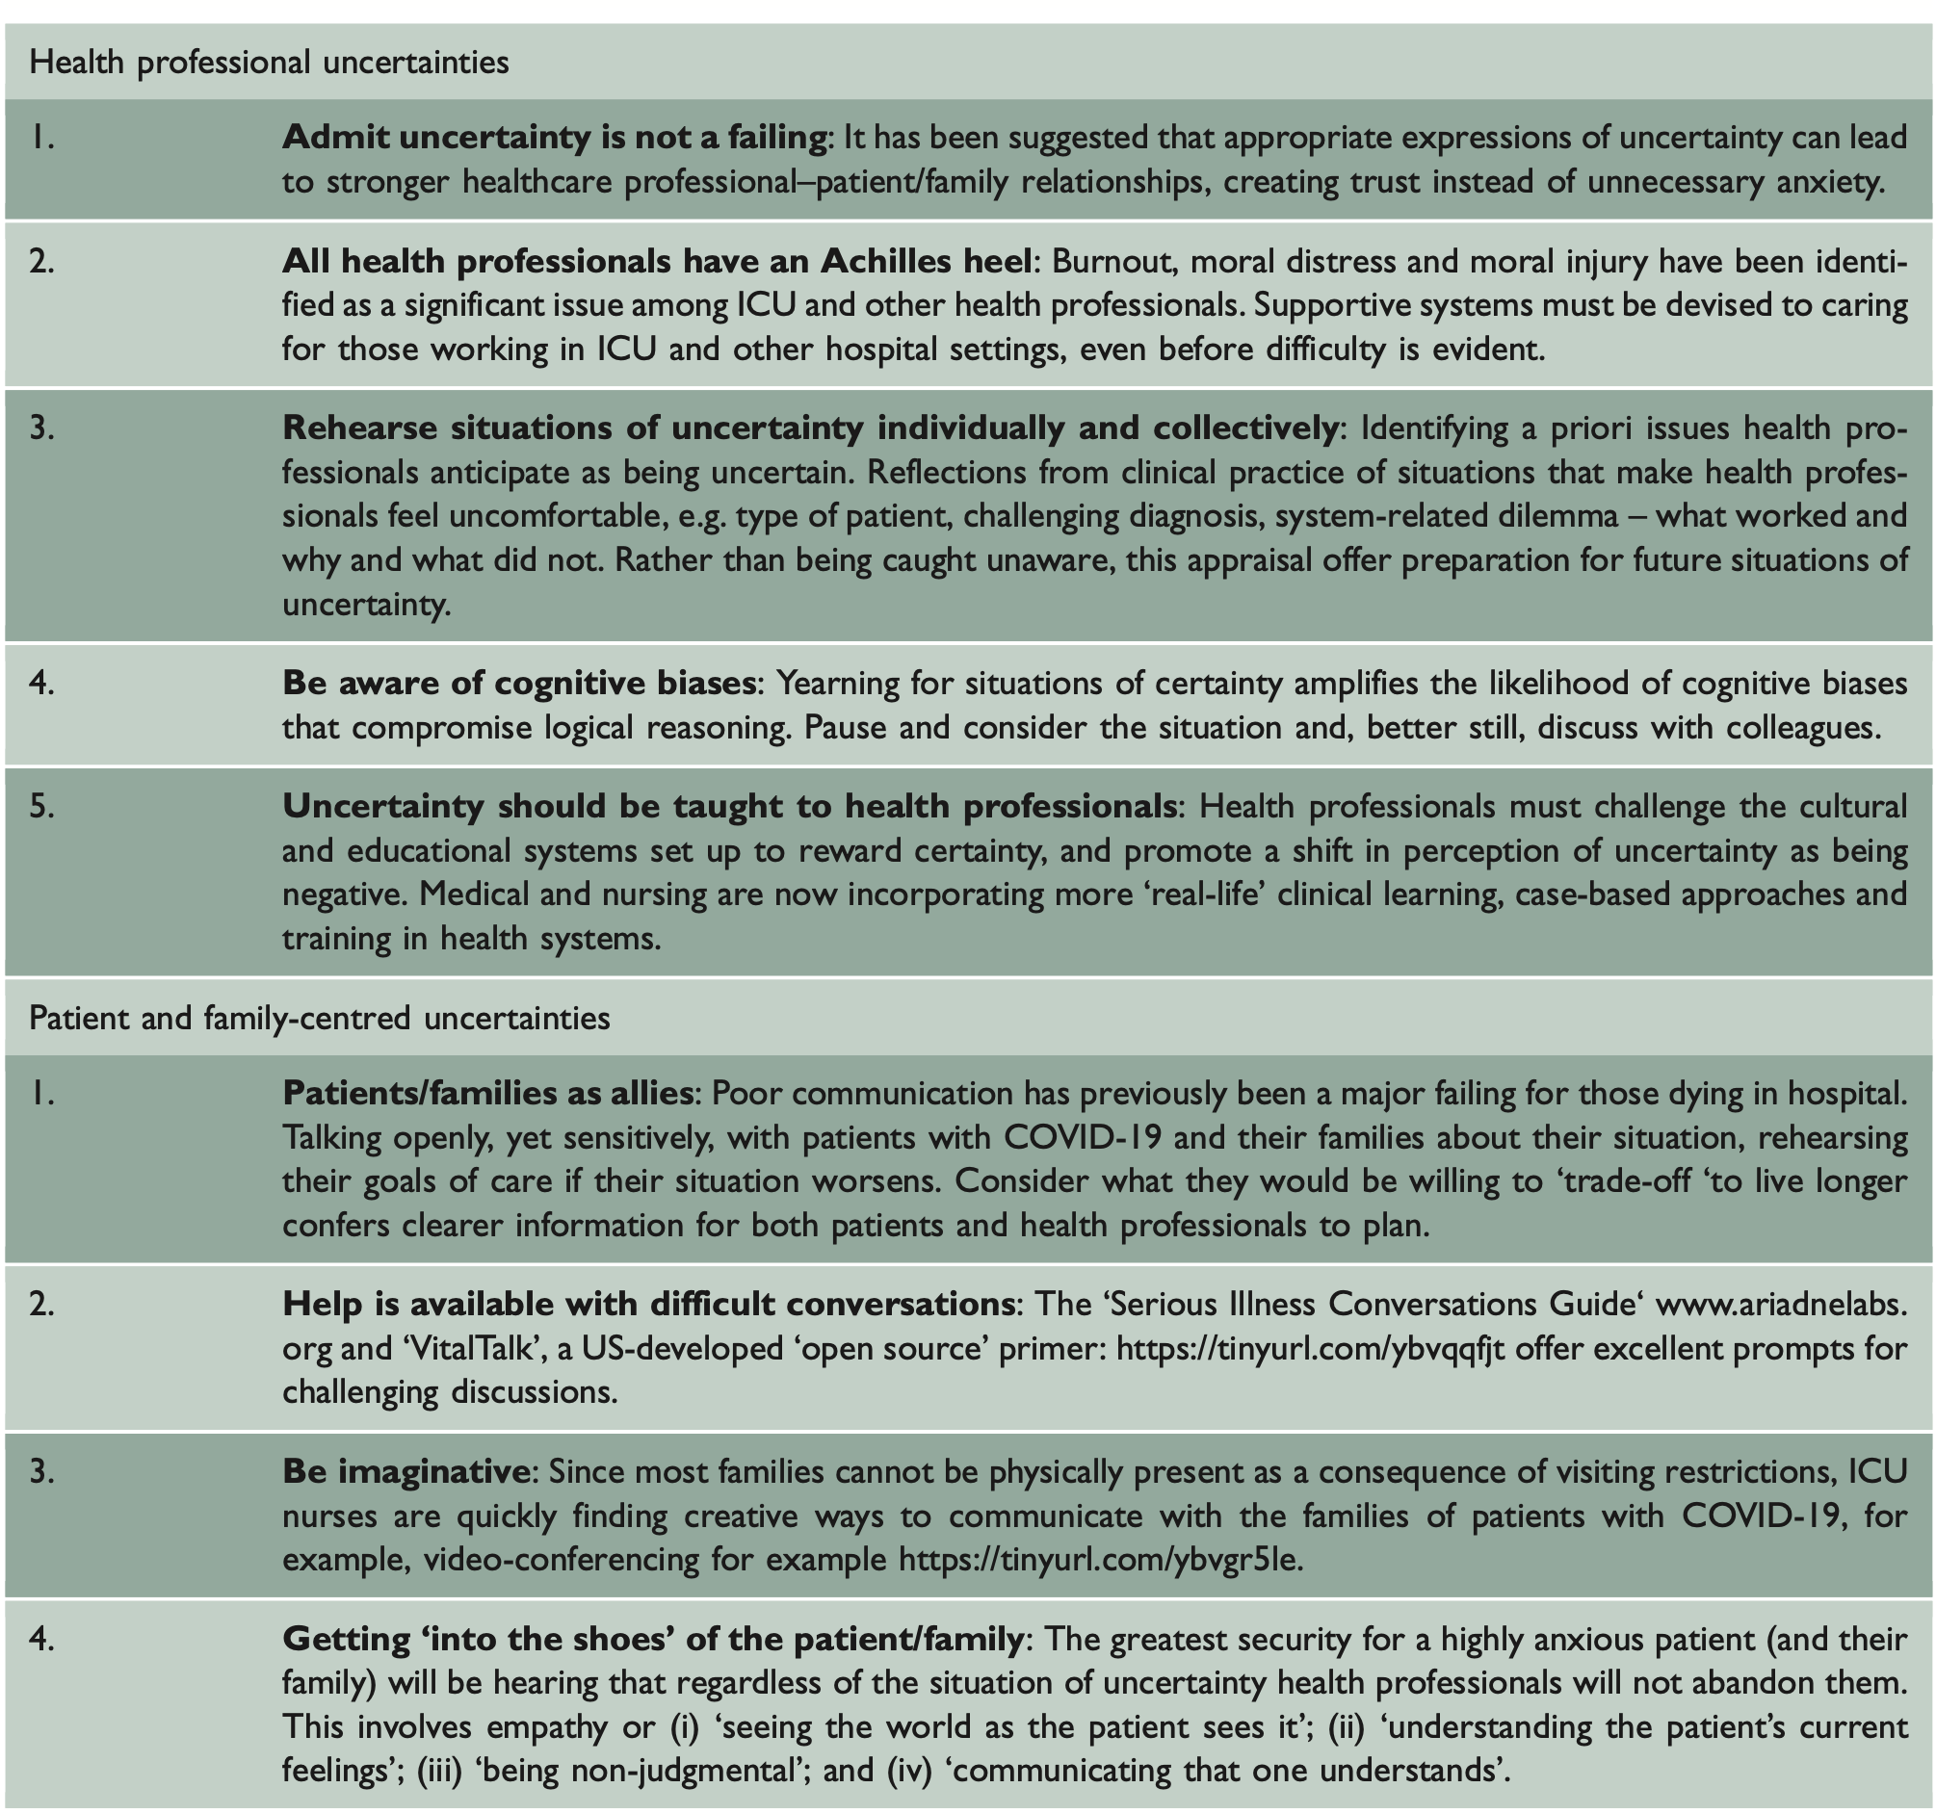

Slide 15
Health Professional Uncertainties
Health professional uncertainties
Patient and family-centred uncertainties
Admit uncertainty is not a failing
All health professionals have an Achilles heel
Rehearse situations of uncertainty individually and collectively
Be aware of cognitive biases
Uncertainty should be taught to health professionals
Patients/families as allies
Help is available with difficult conversations
Be imaginative
Getting ‘into the shoes’ of the patient/family

Slide 16
Health Professional Uncertainties
Health professional uncertainties
Patient and family-centred uncertainties
Admit uncertainty is not a failing
All health professionals have an Achilles heel
Rehearse situations of uncertainty individually and collectively
Be aware of cognitive biases
Uncertainty should be taught to health professionals
Patients/families as allies
Help is available with difficult conversations
Be imaginative
Getting ‘into the shoes’ of the patient/family

Slide 17
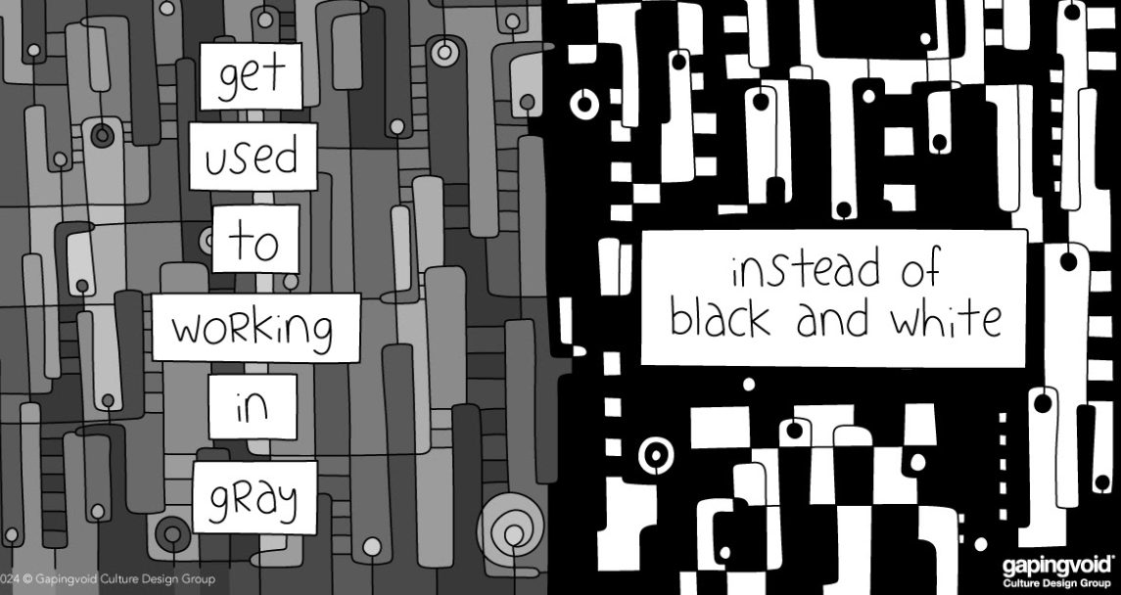
Acknowledge Doubt – this is a positive attribute!!

Slide 18
Acknowledge Doubt – this is a positive attribute!!

Slide 19
Acknowledge Doubt – this is a positive attribute!!

Slide 20
So please help us to help…….
We need to
Think ‘out of the box’
Look at ways of supporting and signposting to the optimal resources

